Slide 1
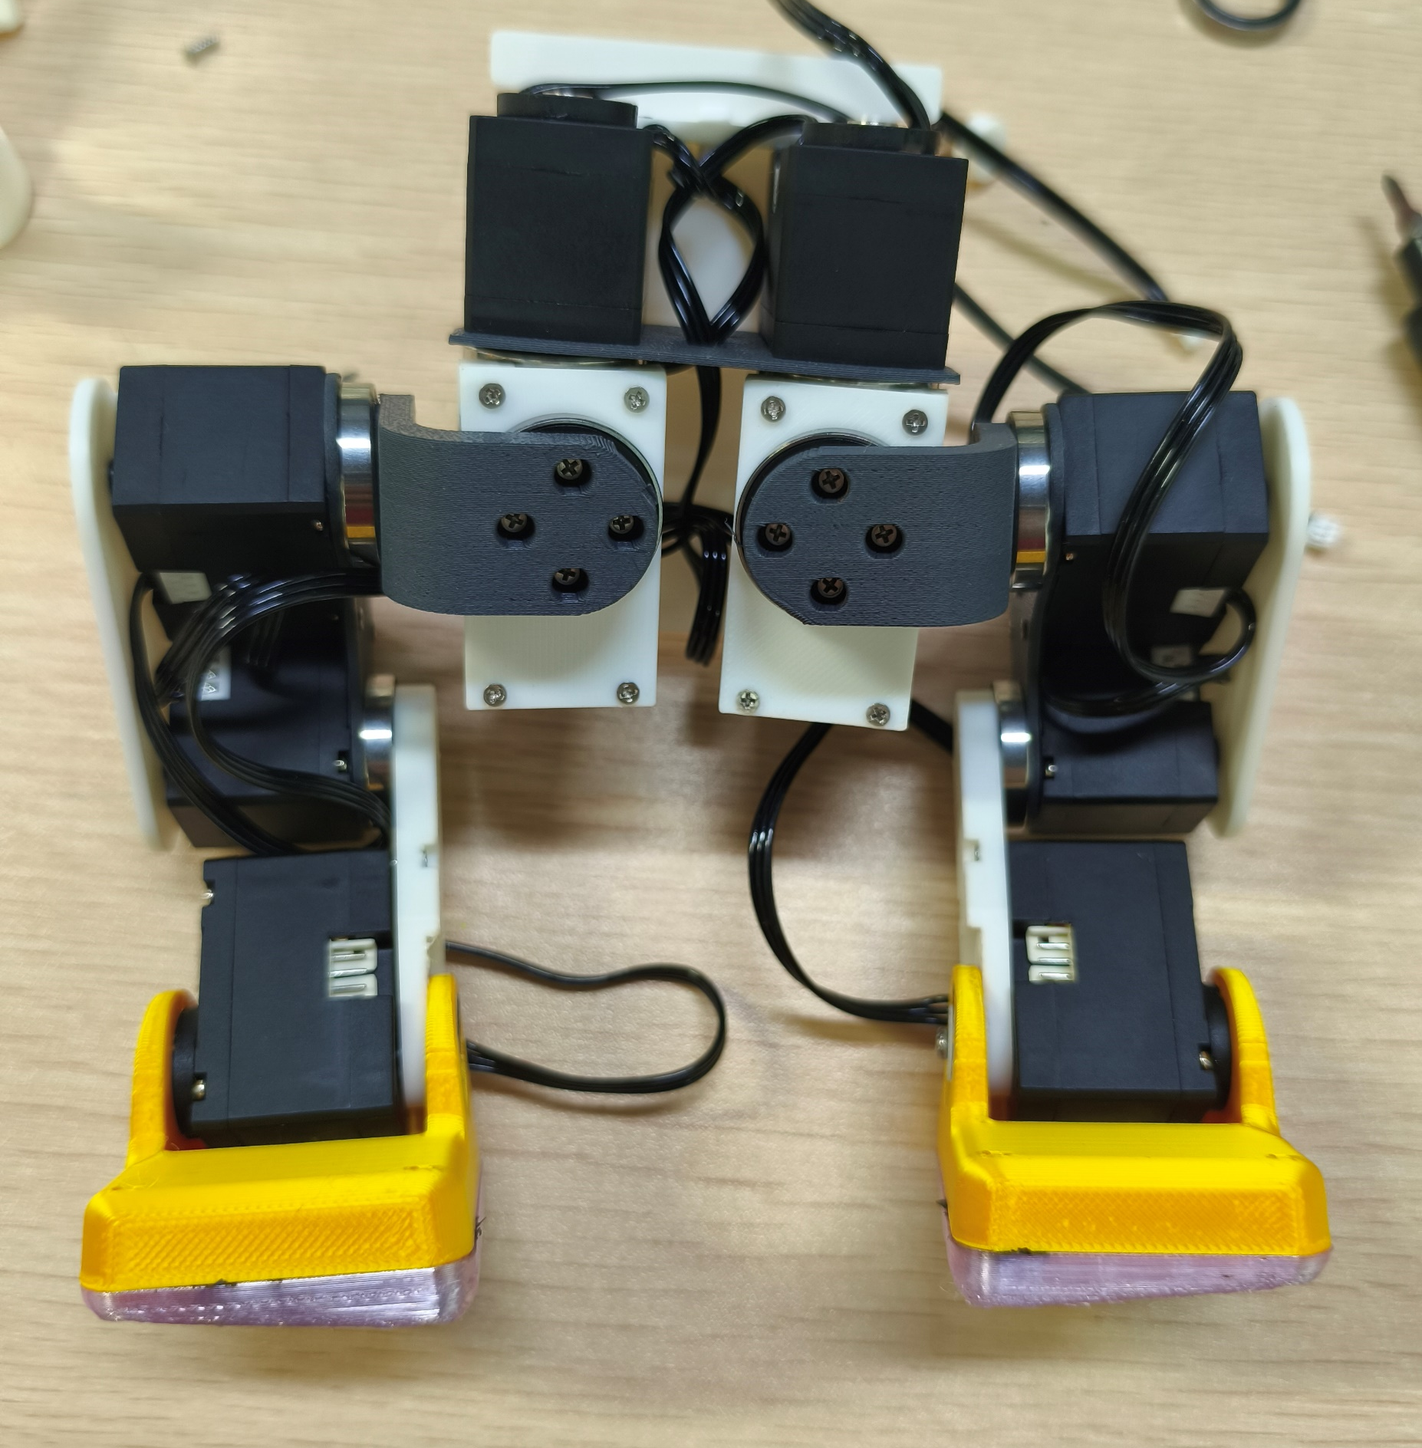
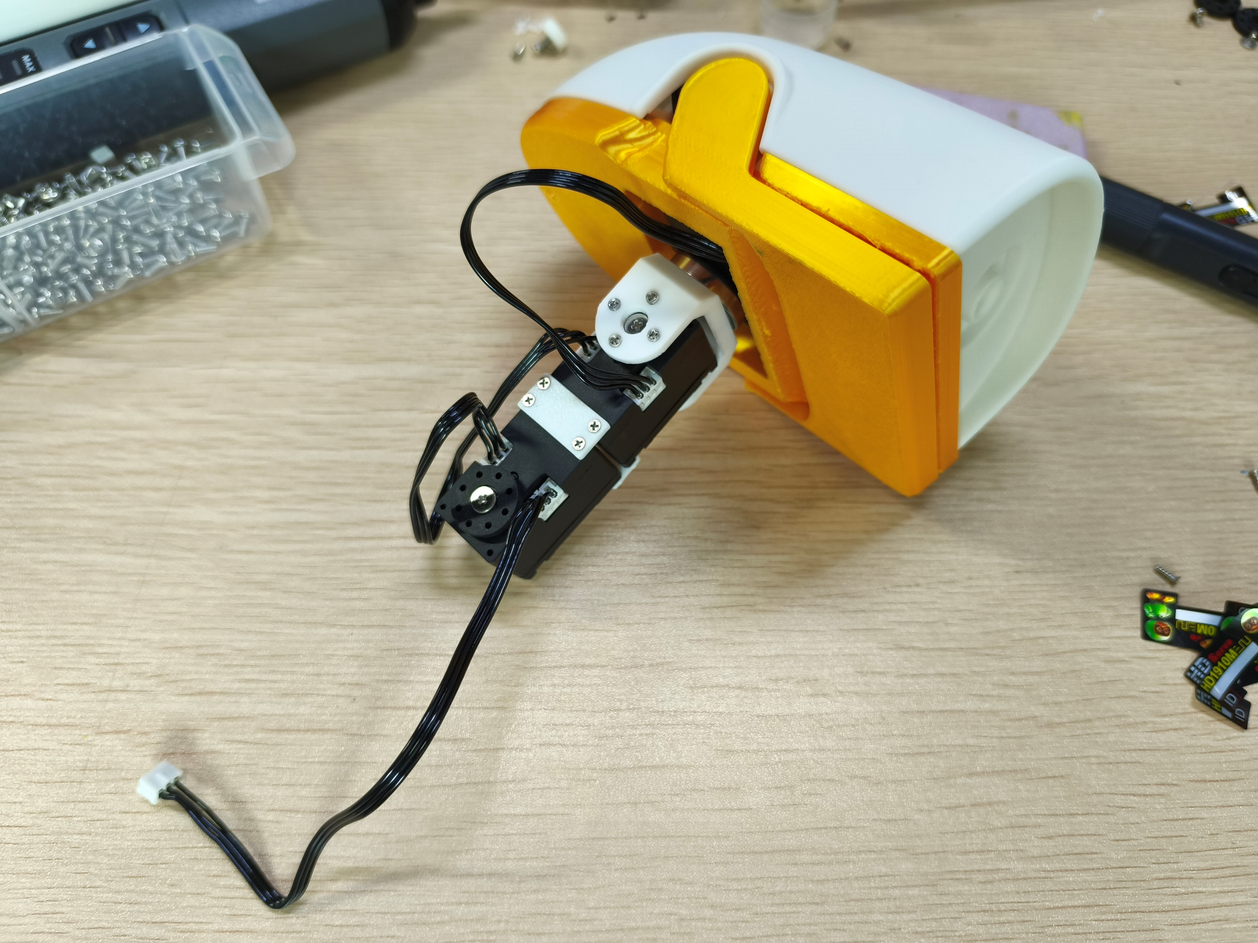
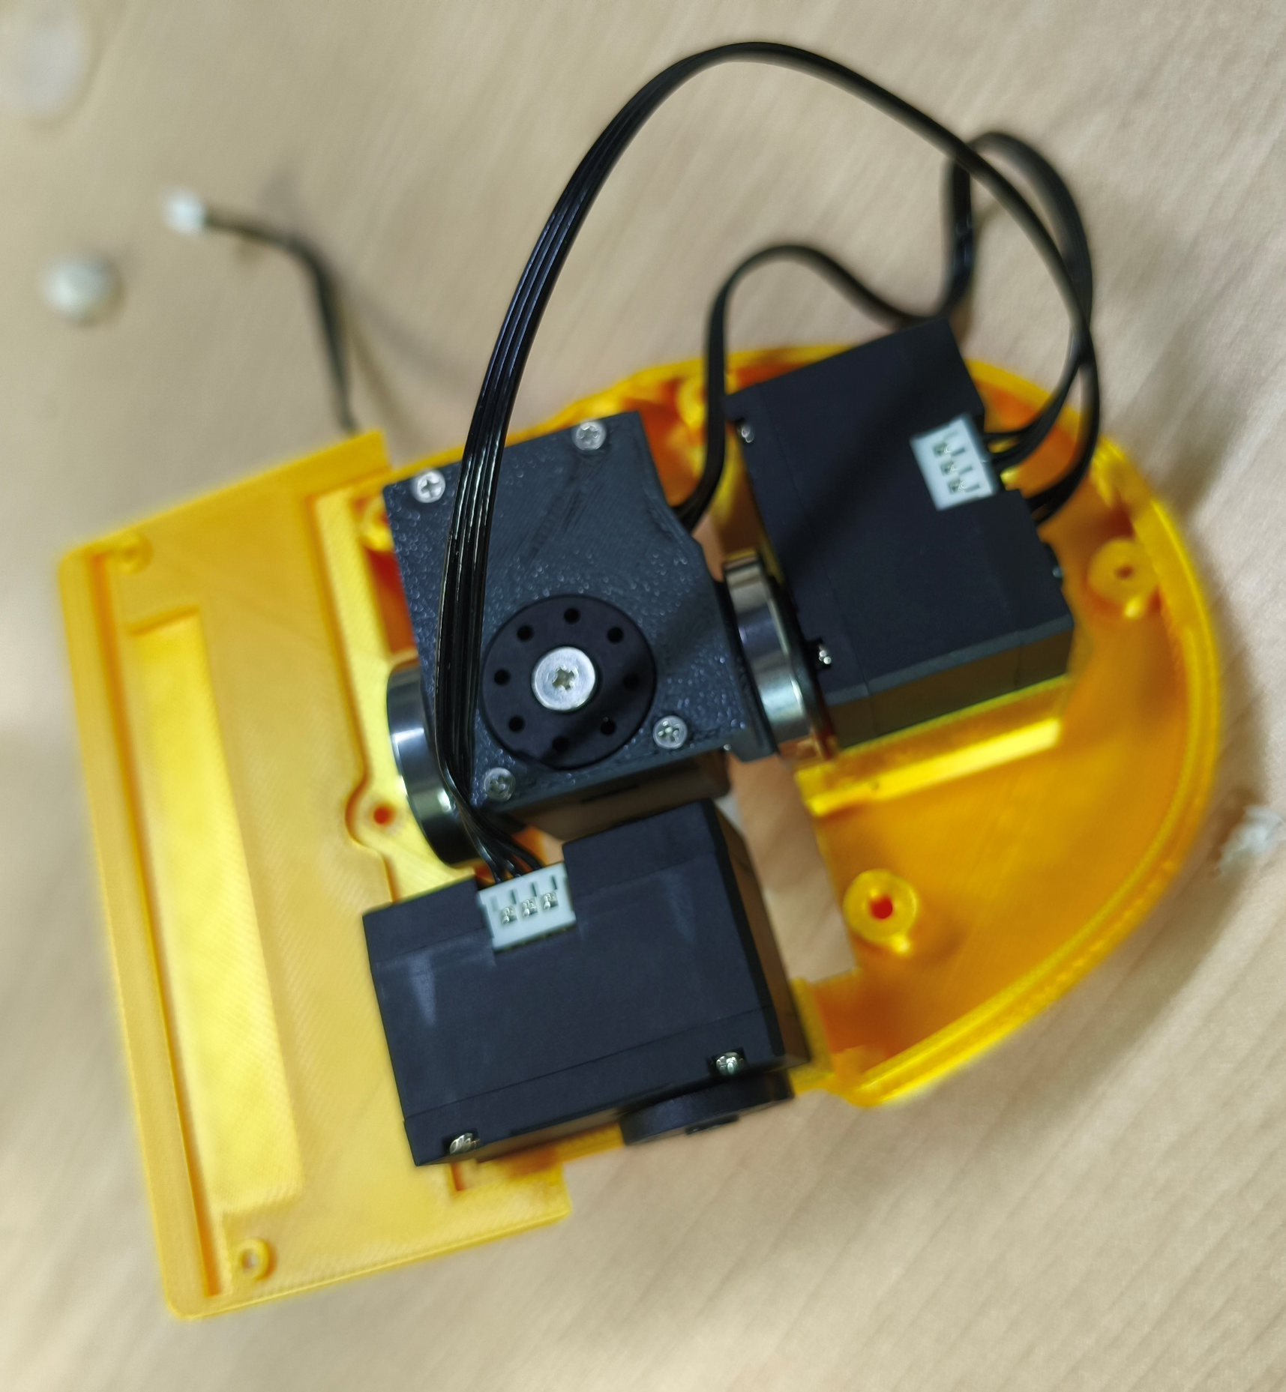
01
舵机 ID 设置
Servo ID setup
按图示设置舵机编号，后续步骤使用相同 ID。
Set the servo IDs as shown. The same IDs are used in the following steps.
20
10
22
21
11
12
32
13
33
23
24
31
14
34
30
01 / 25

Slide 2
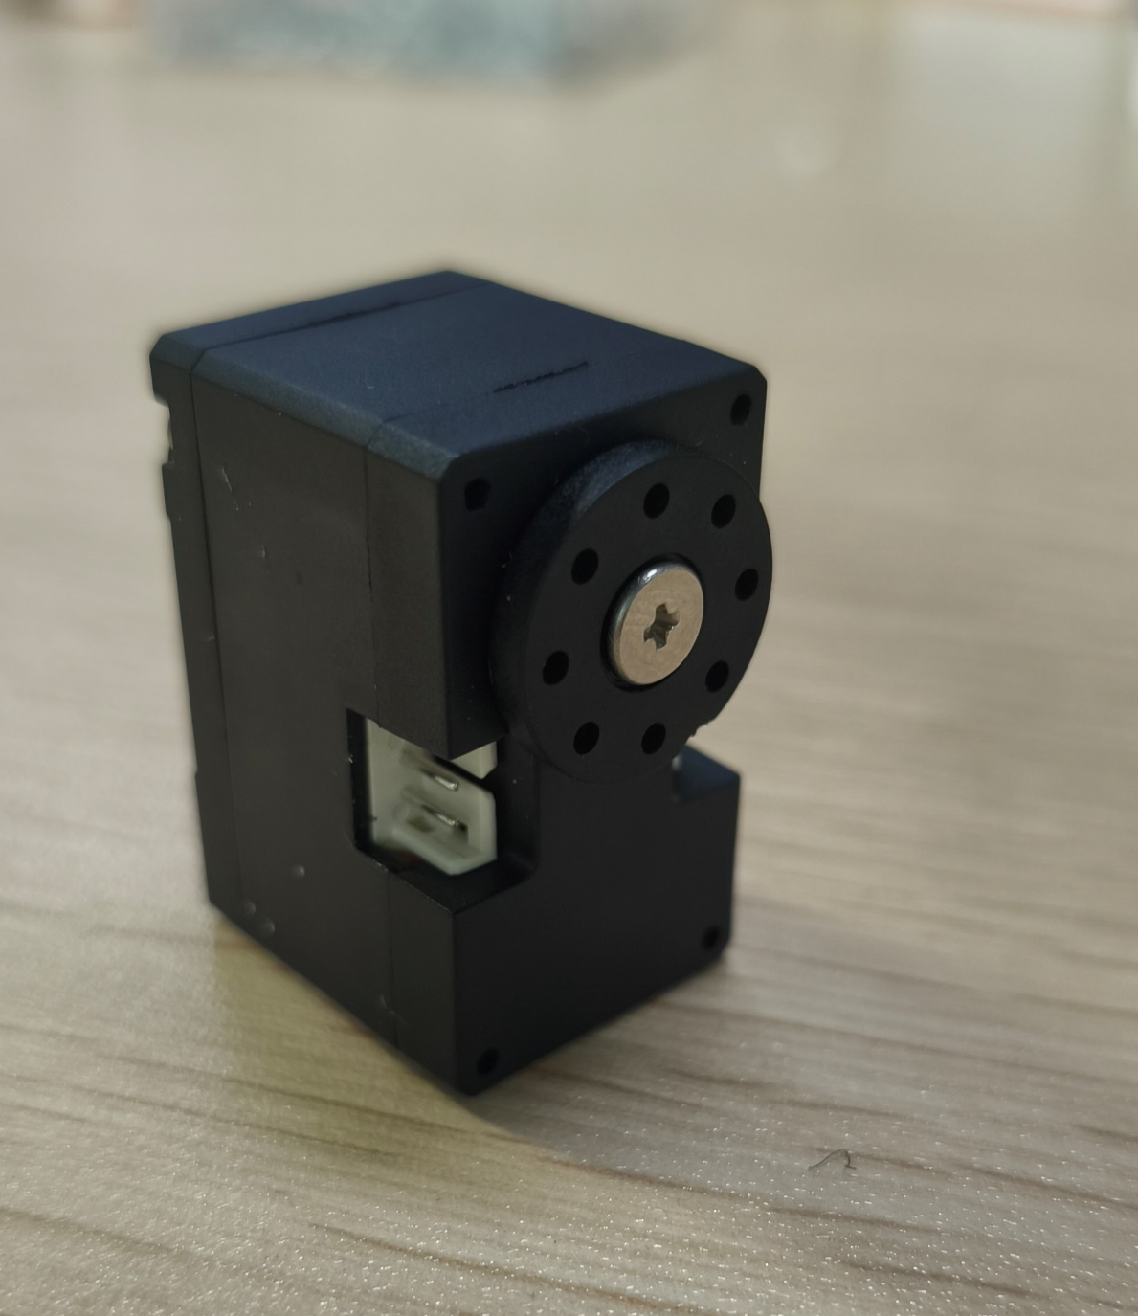
02
舵机副舵盘拆卸
Secondary servo horn removal
保留 ID30、ID31 的副舵盘，ID10、ID20、ID32 可选拆卸。其余舵机拆除副舵盘，勿拆输出轴。
Keep the secondary horns on ID30 and ID31. Removal is optional for ID10, ID20 and ID32.
Remove the secondary horns from all other servos. Do not remove the output shafts.
02 / 25

Slide 3
03
底部舵机与连接板
Base servos and connecting plate
按箭头方向走线，红圈孔位暂不安装螺丝。15cm长舵机线用于ID10和20连接主板。
Route the cables as shown. Leave the holes marked in red without screws for now.
15 cm servo wire, used to connect ID10 and ID20 to the main board.
20
走线方向
Cable routing
10
20
10
暂不装螺丝
No screws yet
沉头自攻螺丝 M2×6：6 颗
M2×6 countersunk self-tapping screws: 6 pcs
03 / 25

Slide 4
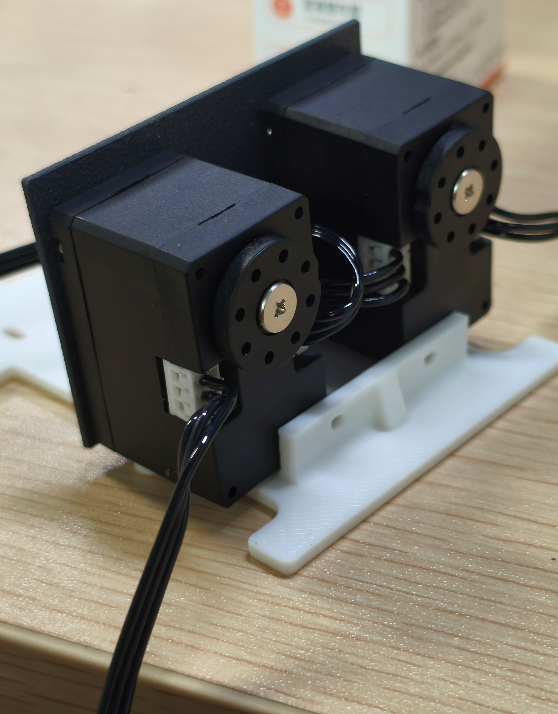
04
底座支架安装
Base bracket installation
螺丝
Screws
螺丝
Screws
沉头自攻螺丝 M2×6：4 颗
M2×6 countersunk self-tapping screws: 4 pcs
04 / 25

Slide 5
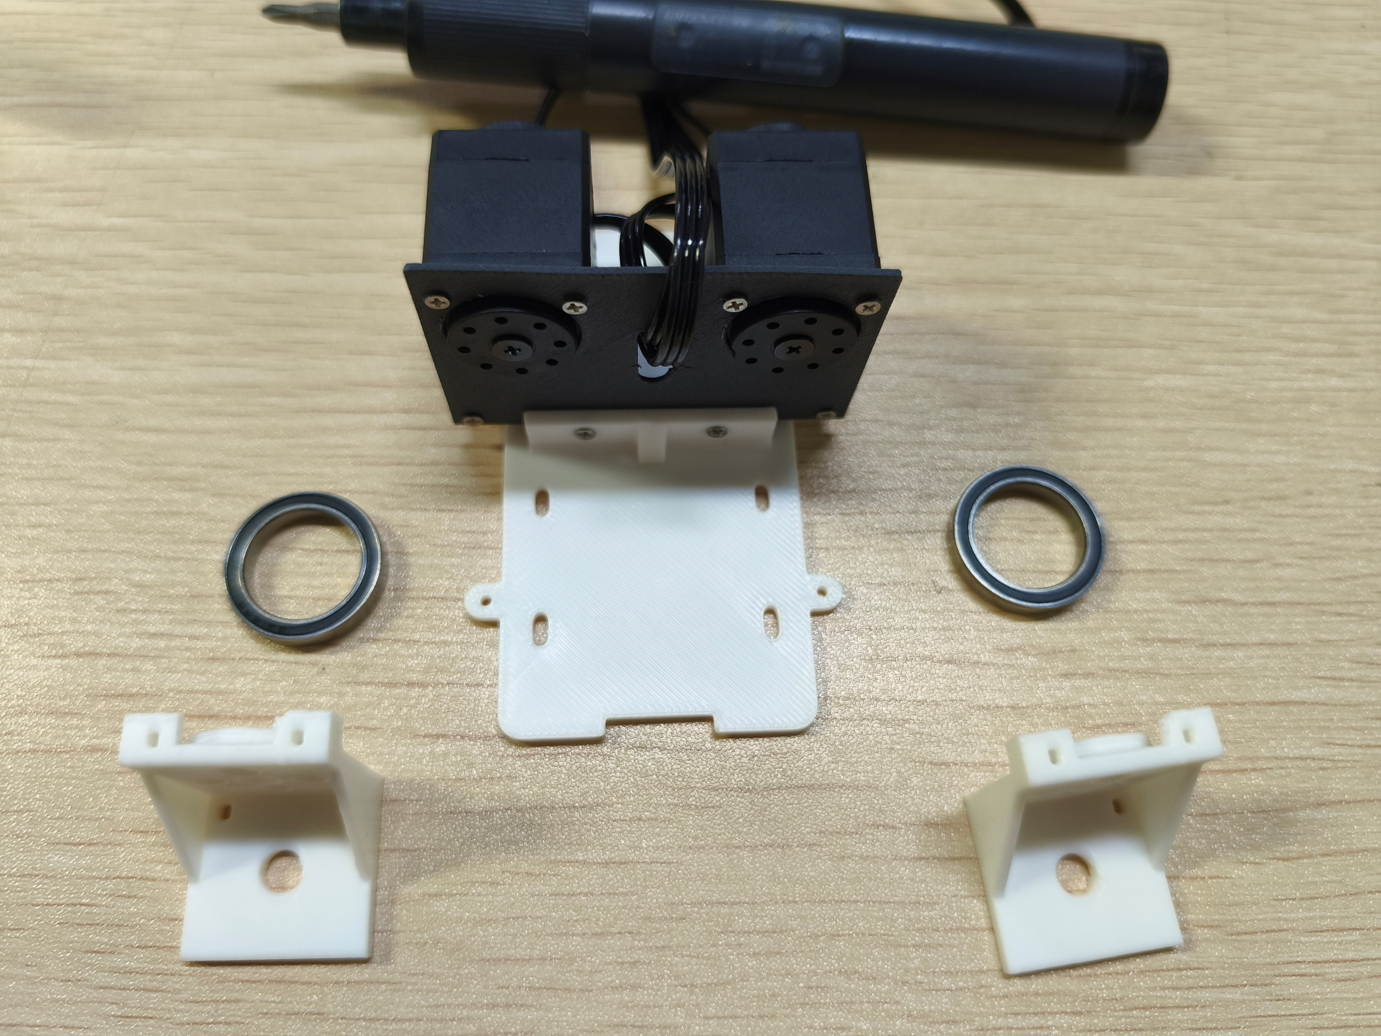
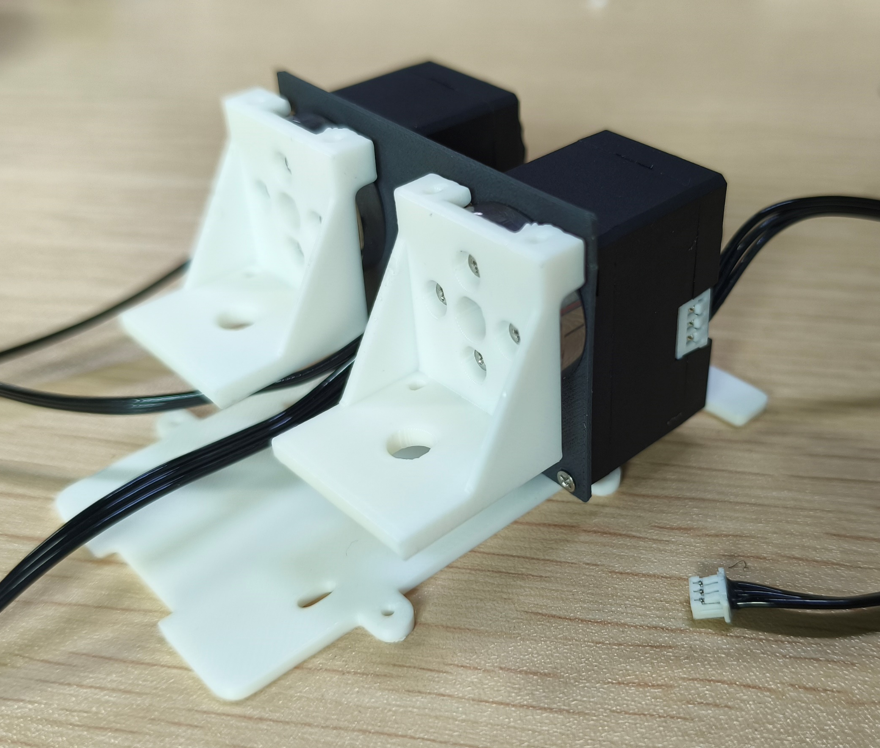
05
侧支架与轴承安装
Side brackets and bearings
螺丝
Screws
沉头自攻螺丝 M2×6：8 颗
M2×6 countersunk self-tapping screws: 8 pcs
05 / 25

Slide 6
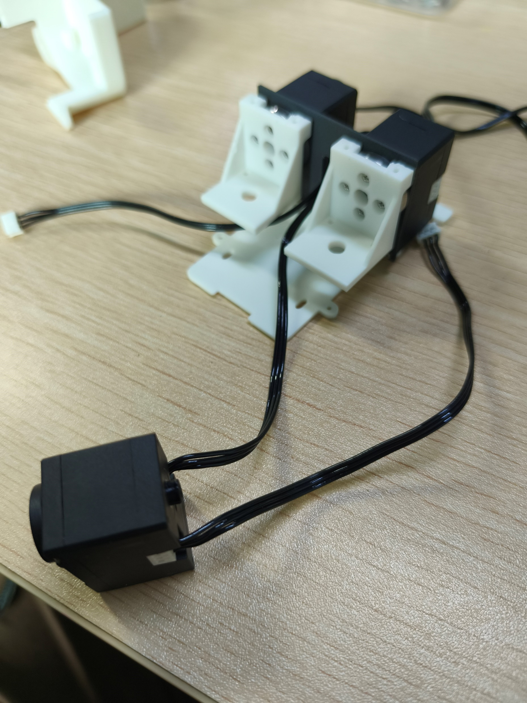
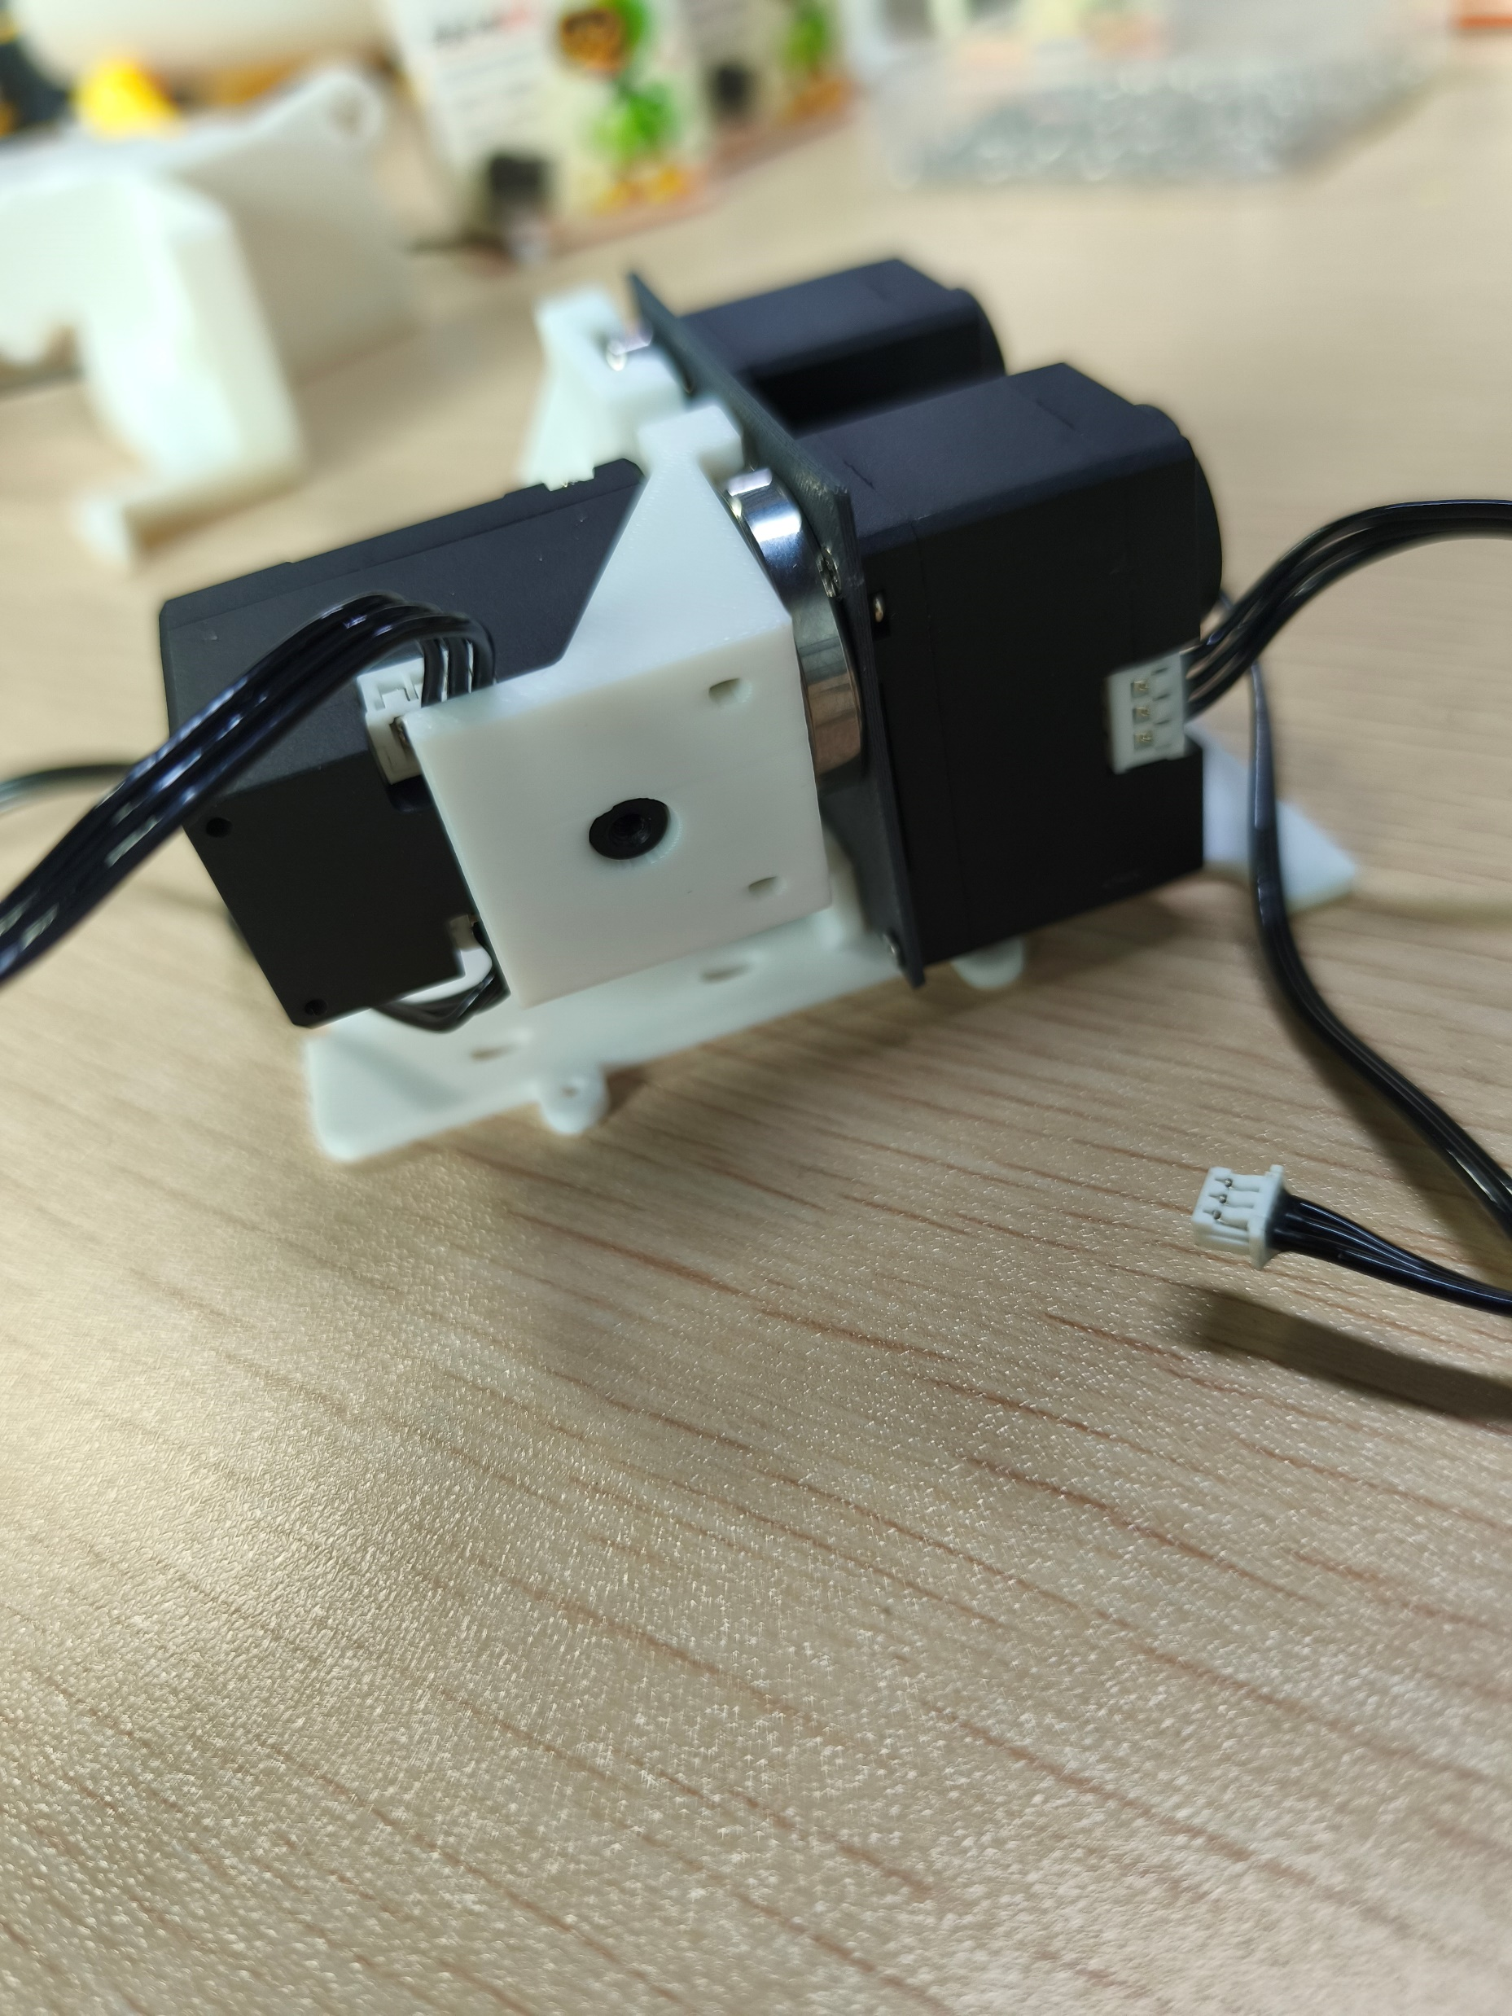
06
腿部舵机连接
Leg servo connection
先连接线缆，再固定舵机。
Connect the cables before securing the servos.
10
10
11
螺丝
Screws
11
沉头自攻螺丝 M2×6：4 颗
M2×6 countersunk self-tapping screws: 4 pcs
06 / 25

Slide 7
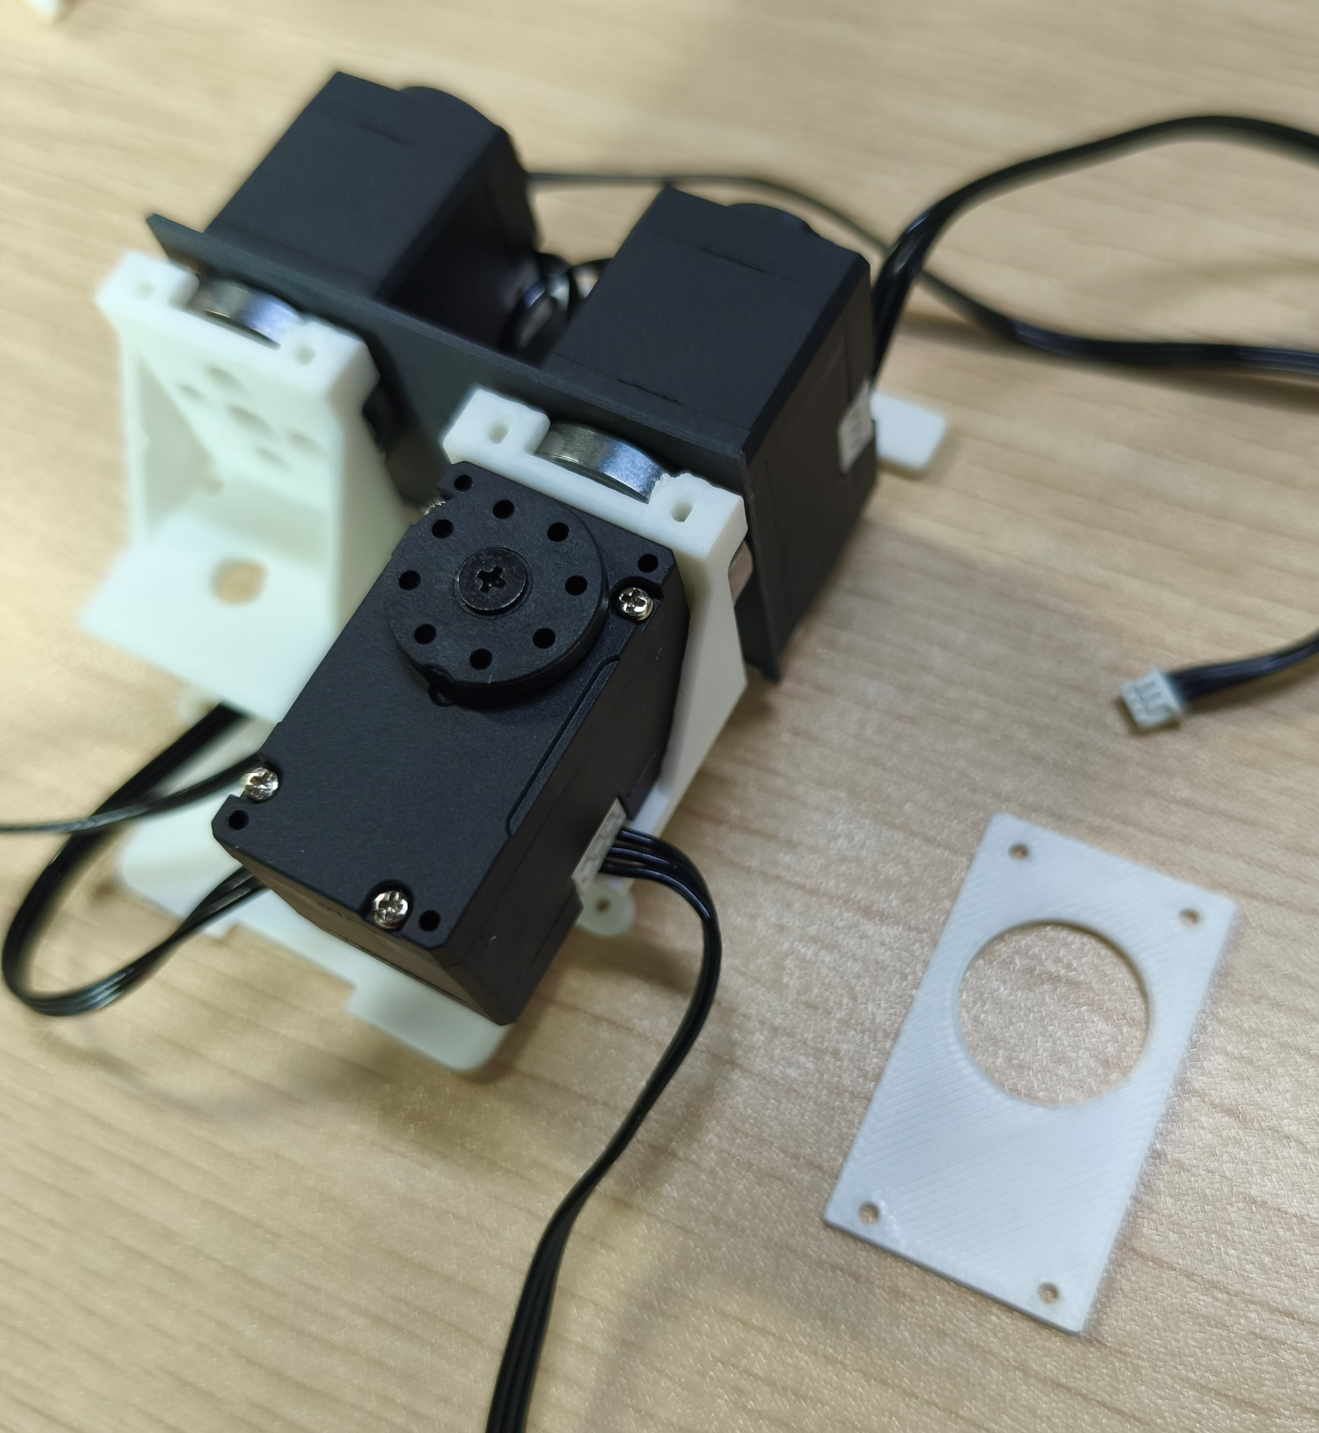
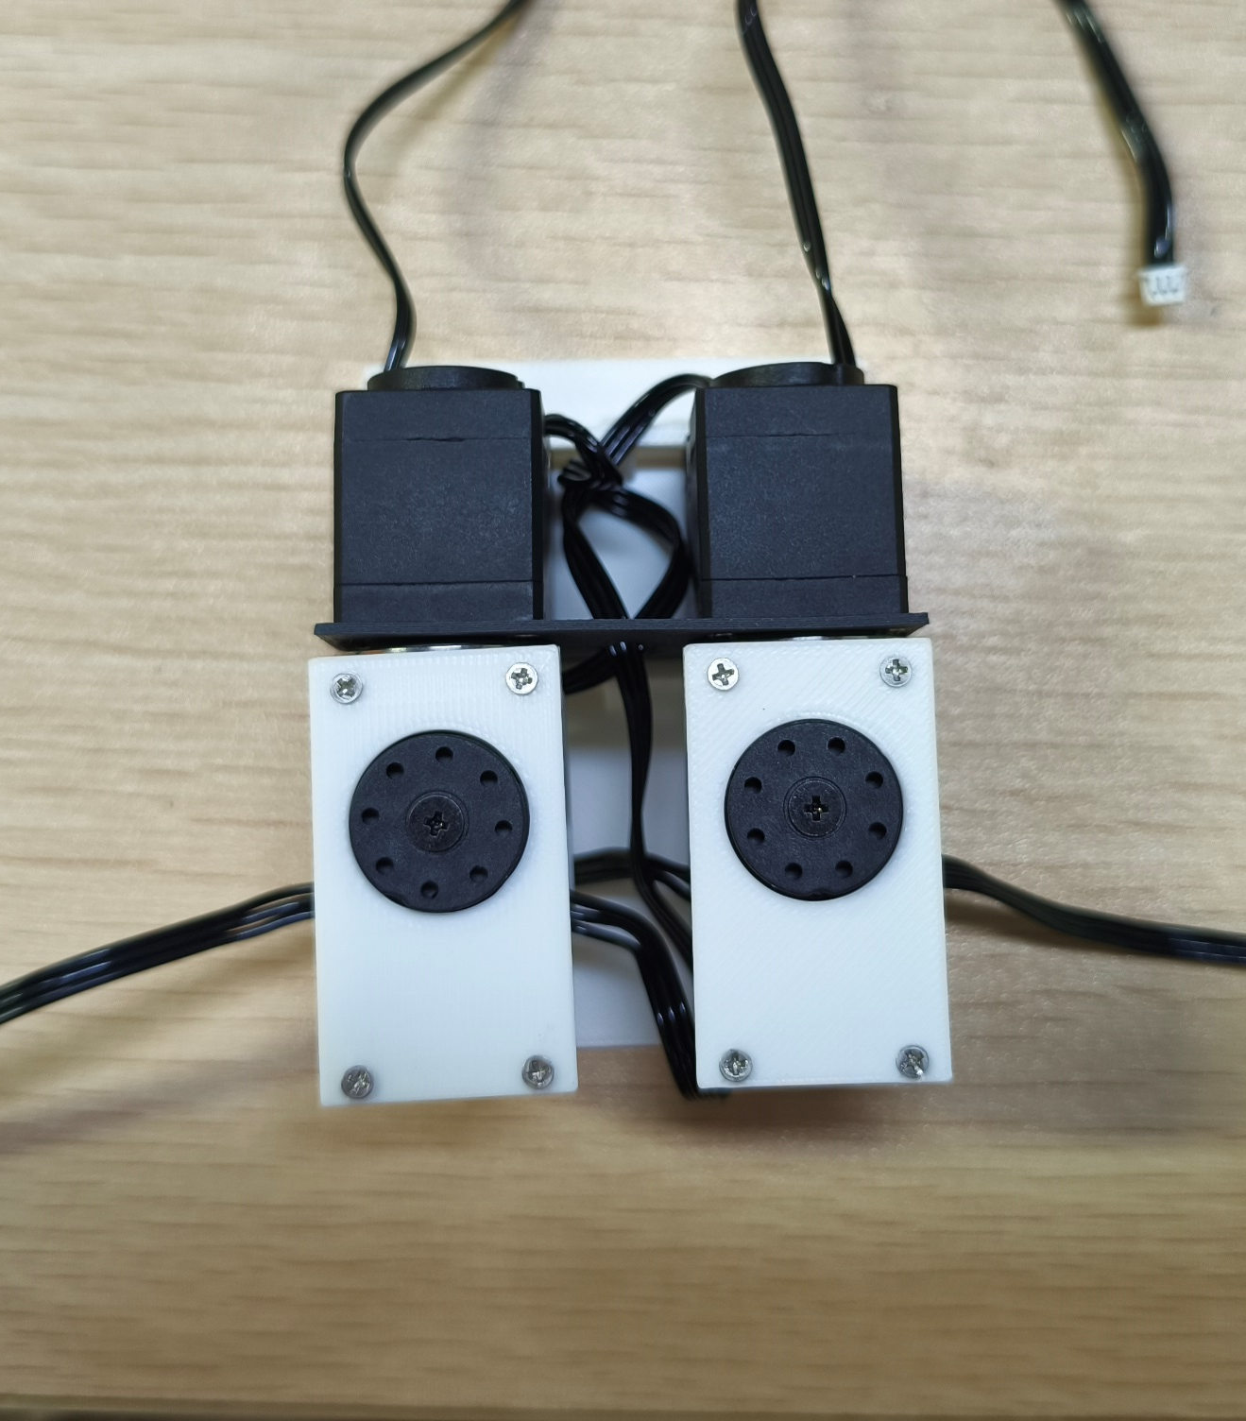
07
腿部连接板固定
Leg connecting plates
沉头自攻螺丝 M2×6：8 颗
M2×6 countersunk self-tapping screws: 8 pcs
07 / 25

Slide 8
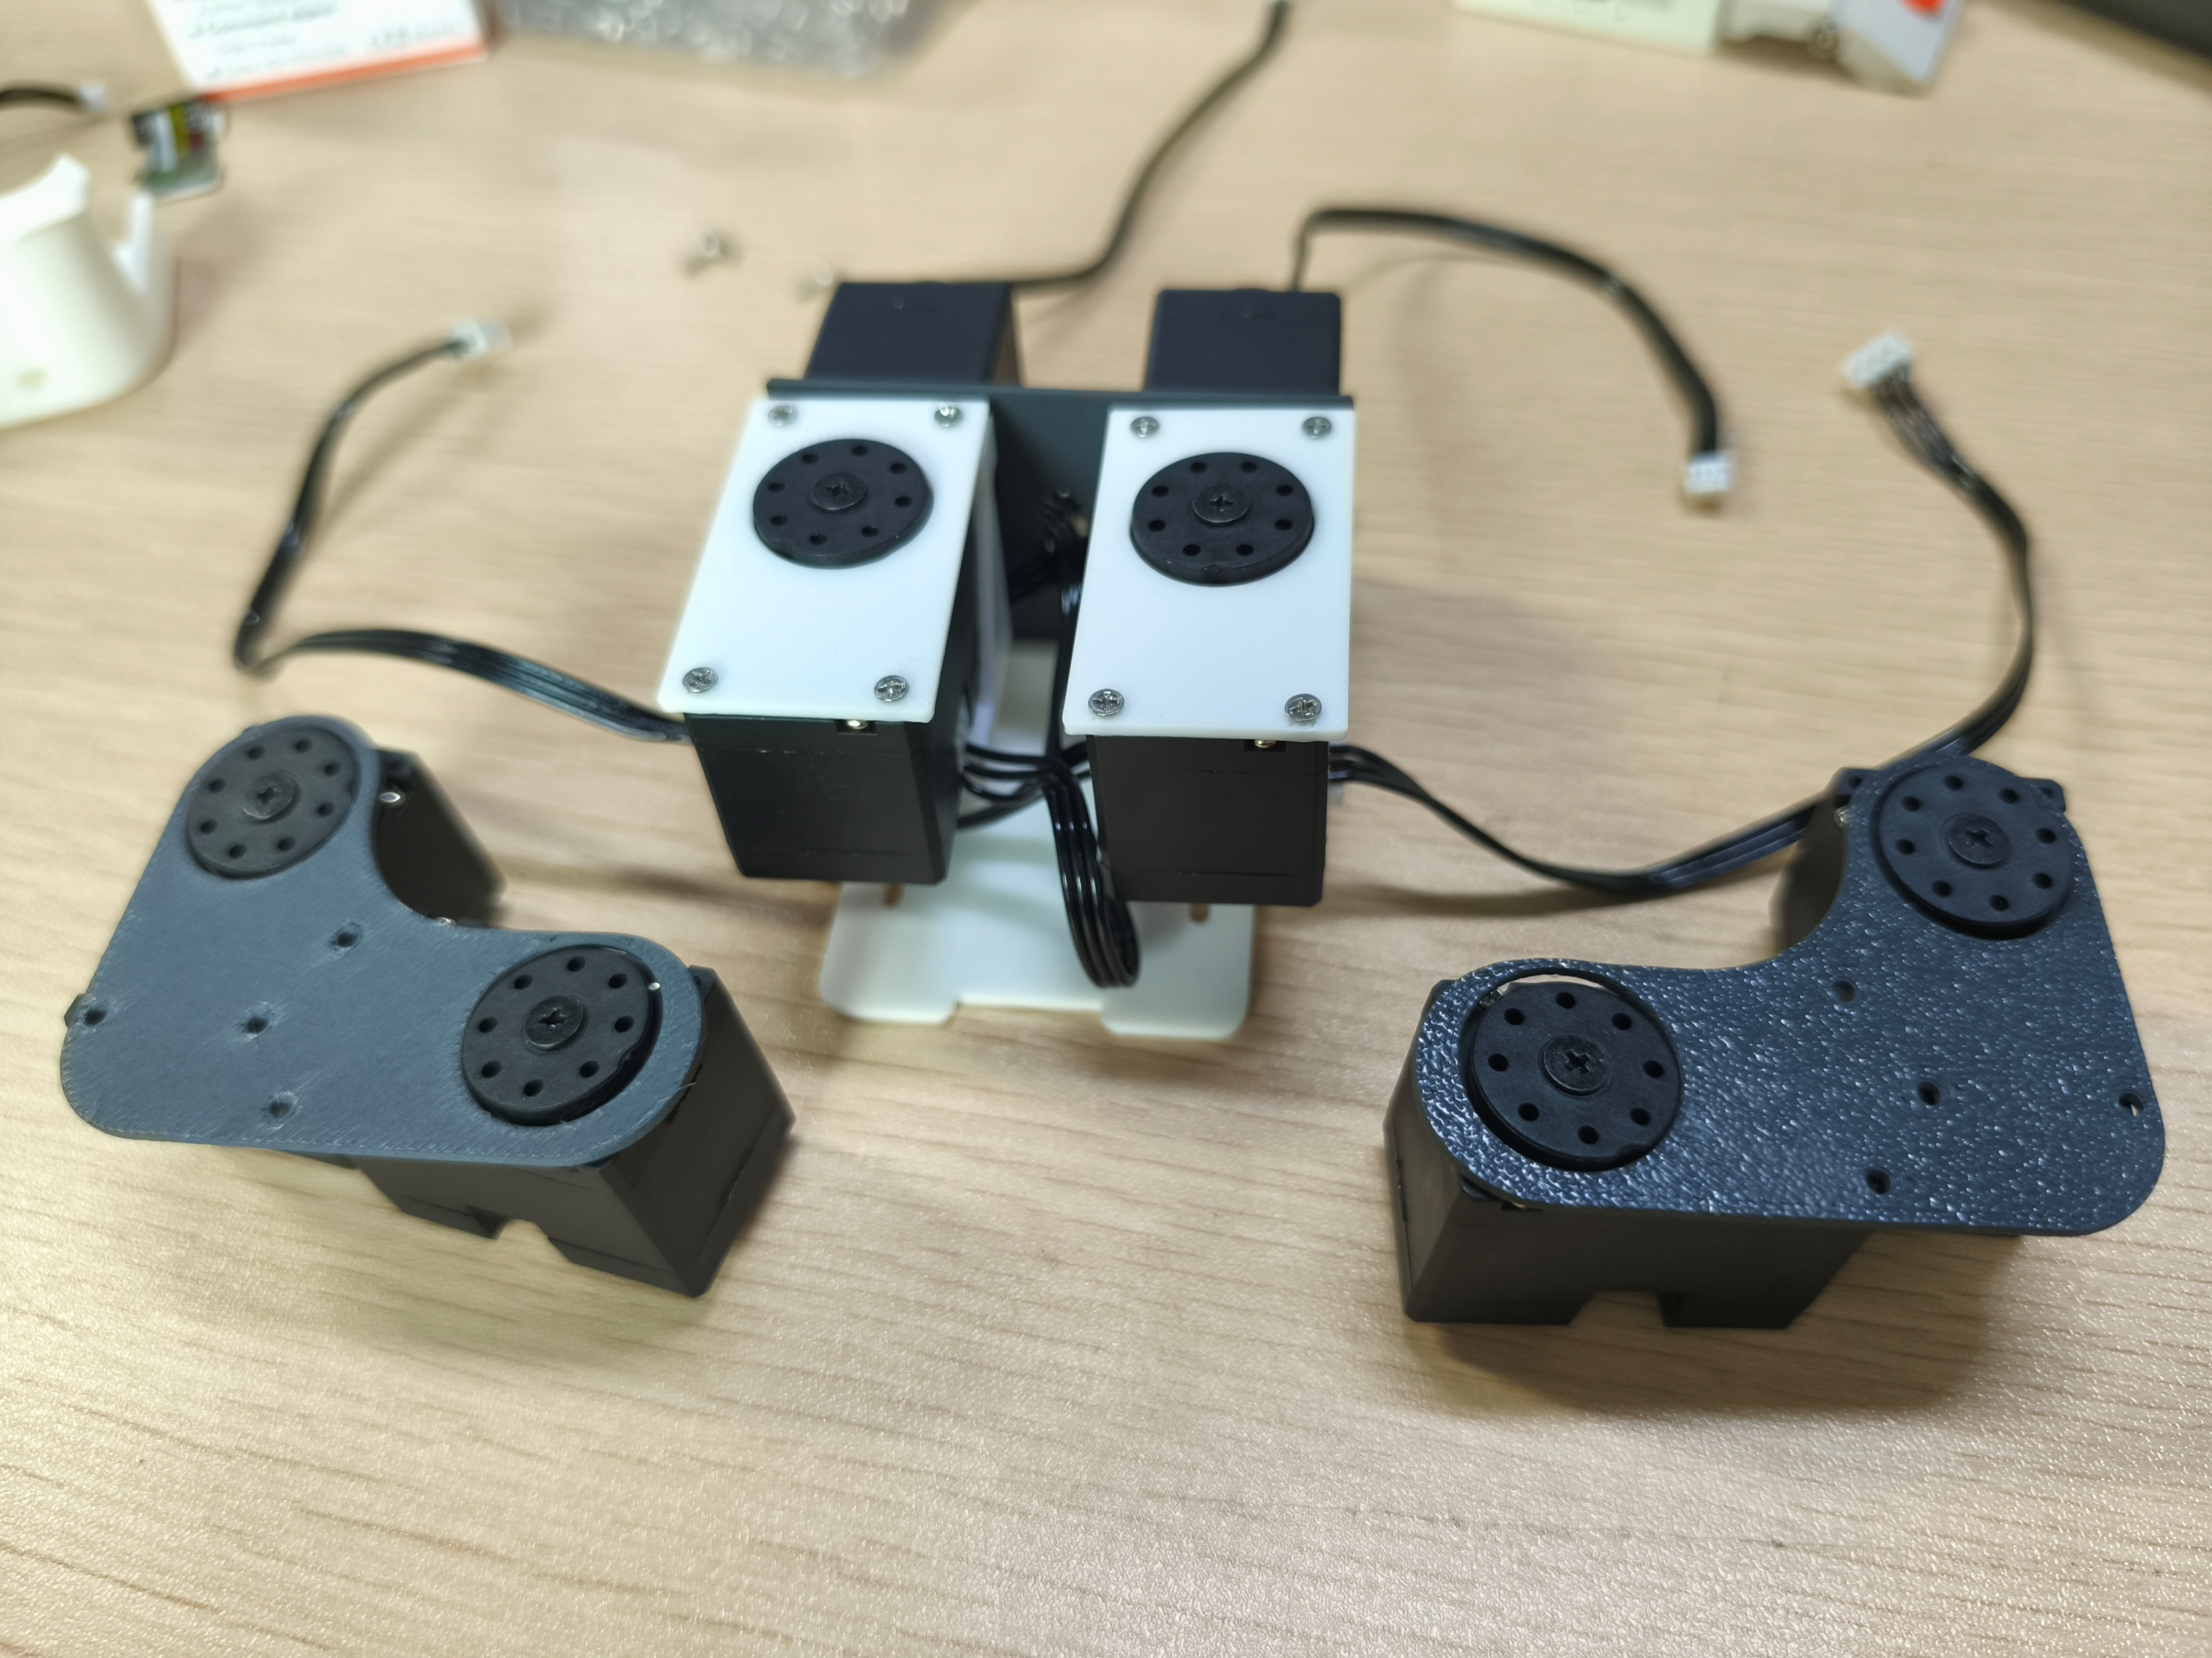
08
左右腿舵机组合
Left and right leg servo assemblies
注意左右方向，按图核对舵机编号与安装朝向。
Check the left and right orientations, servo IDs and mounting directions shown.
20
10
21
11
23
13
22
12
沉头自攻螺丝 M2×6：8 颗
M2×6 countersunk self-tapping screws: 8 pcs
08 / 25

Slide 9
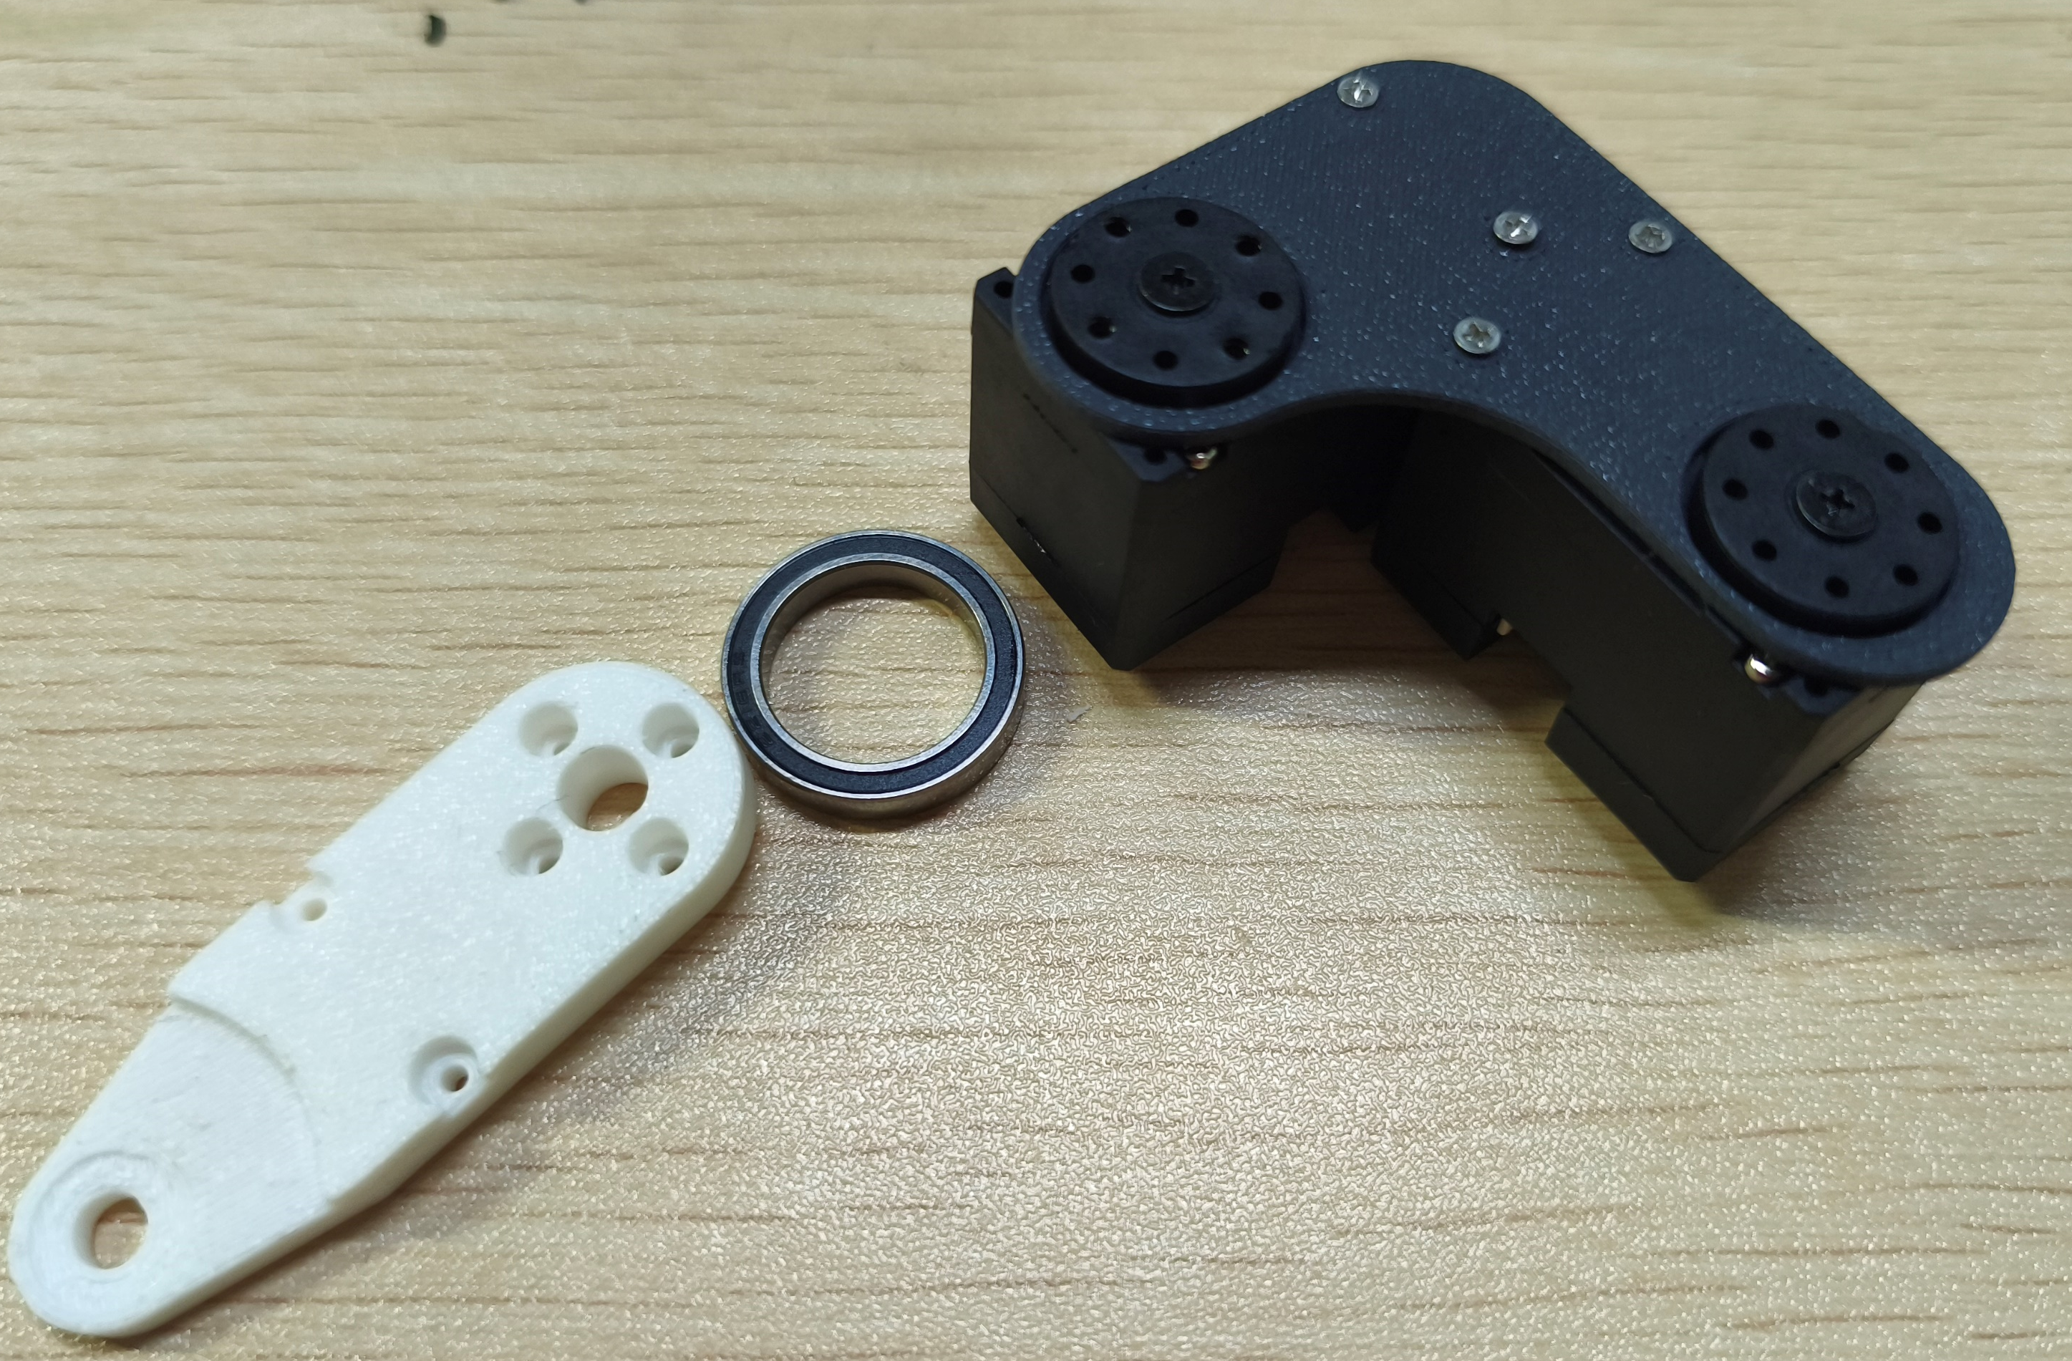
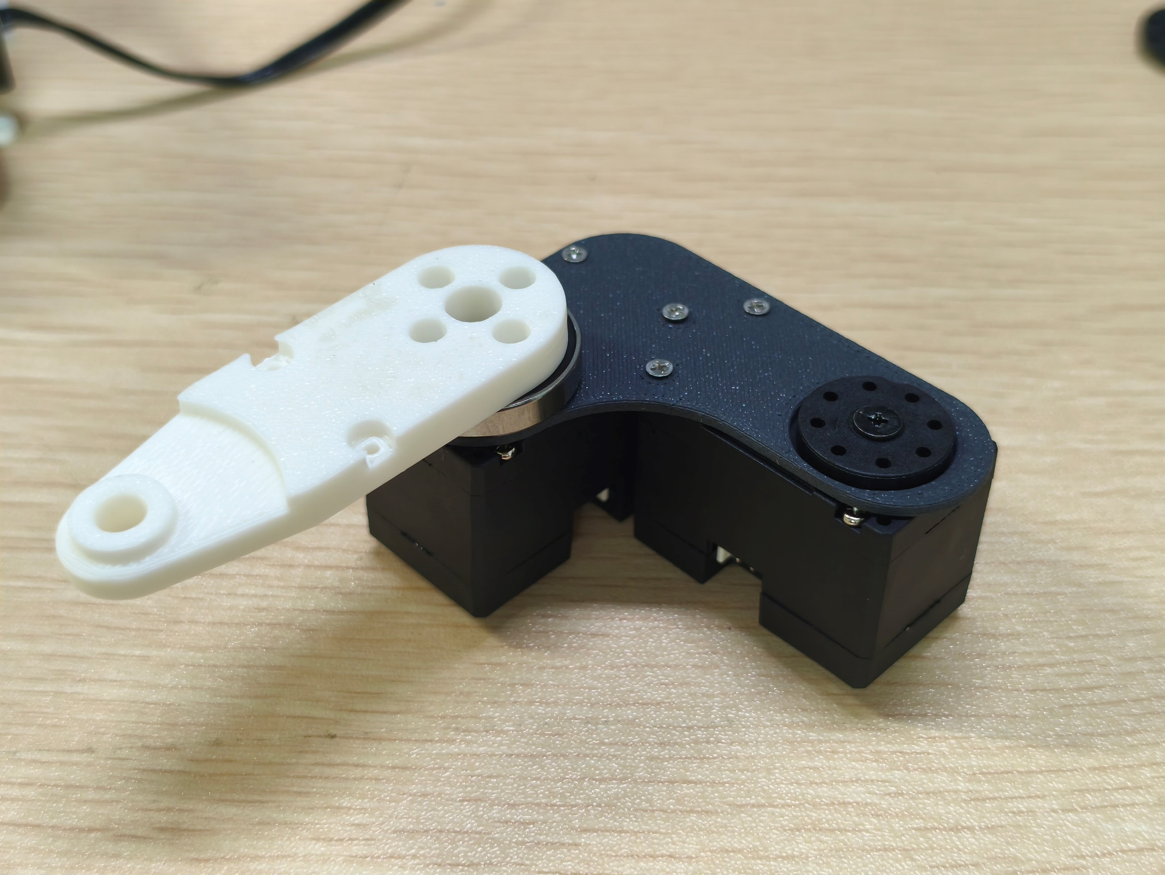
09
腿部连杆安装
Leg linkage installation
13
12
沉头自攻螺丝 M2×6：4 颗
M2×6 countersunk self-tapping screws: 4 pcs
09 / 25

Slide 10
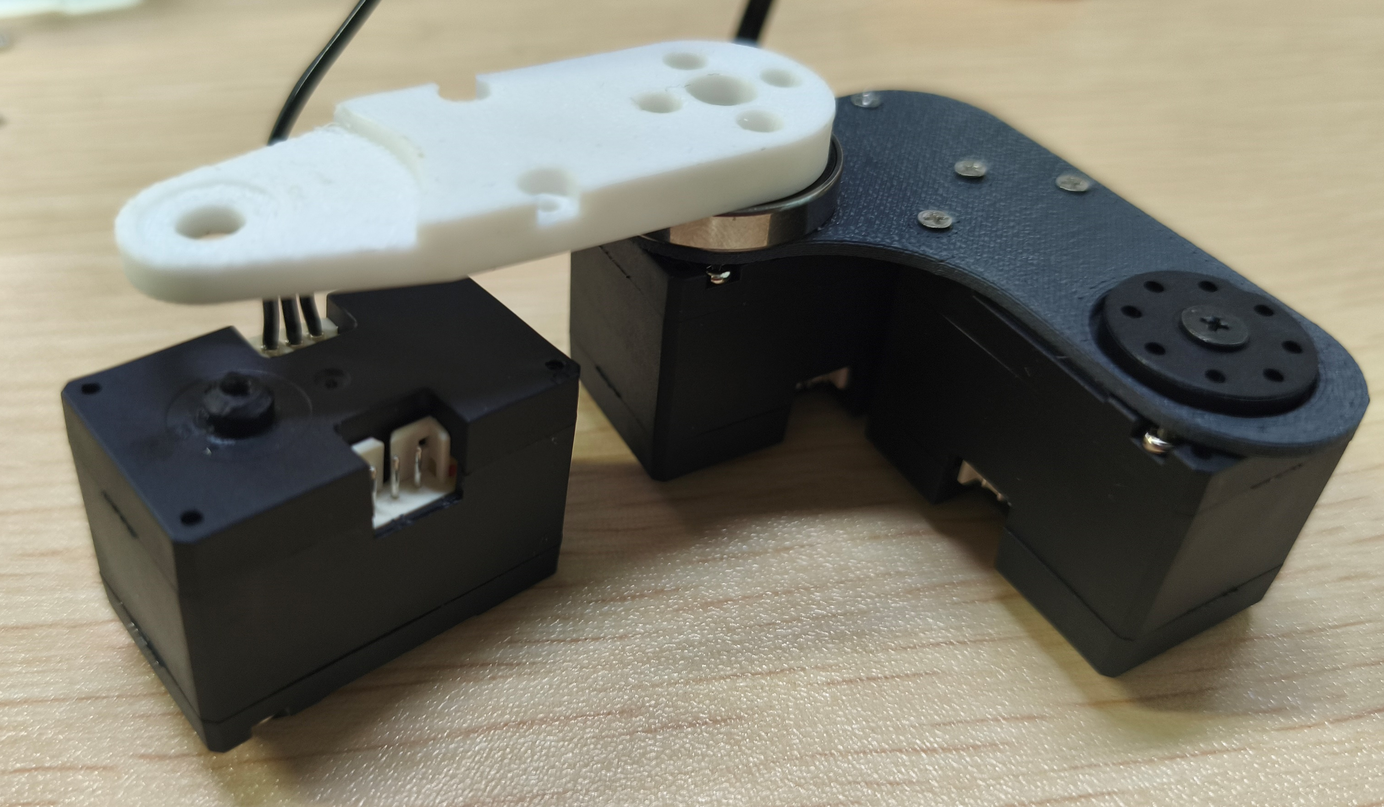
10
脚部舵机连接
Foot servo connection
先连接 ID13 与 ID14 的线缆，再安装固定。
Connect the cable between ID13 and ID14 before securing the assembly.
螺丝
Screws
13
12
14
沉头自攻螺丝 M2×6：2 颗
M2×6 countersunk self-tapping screws: 2 pcs
10 / 25

Slide 11
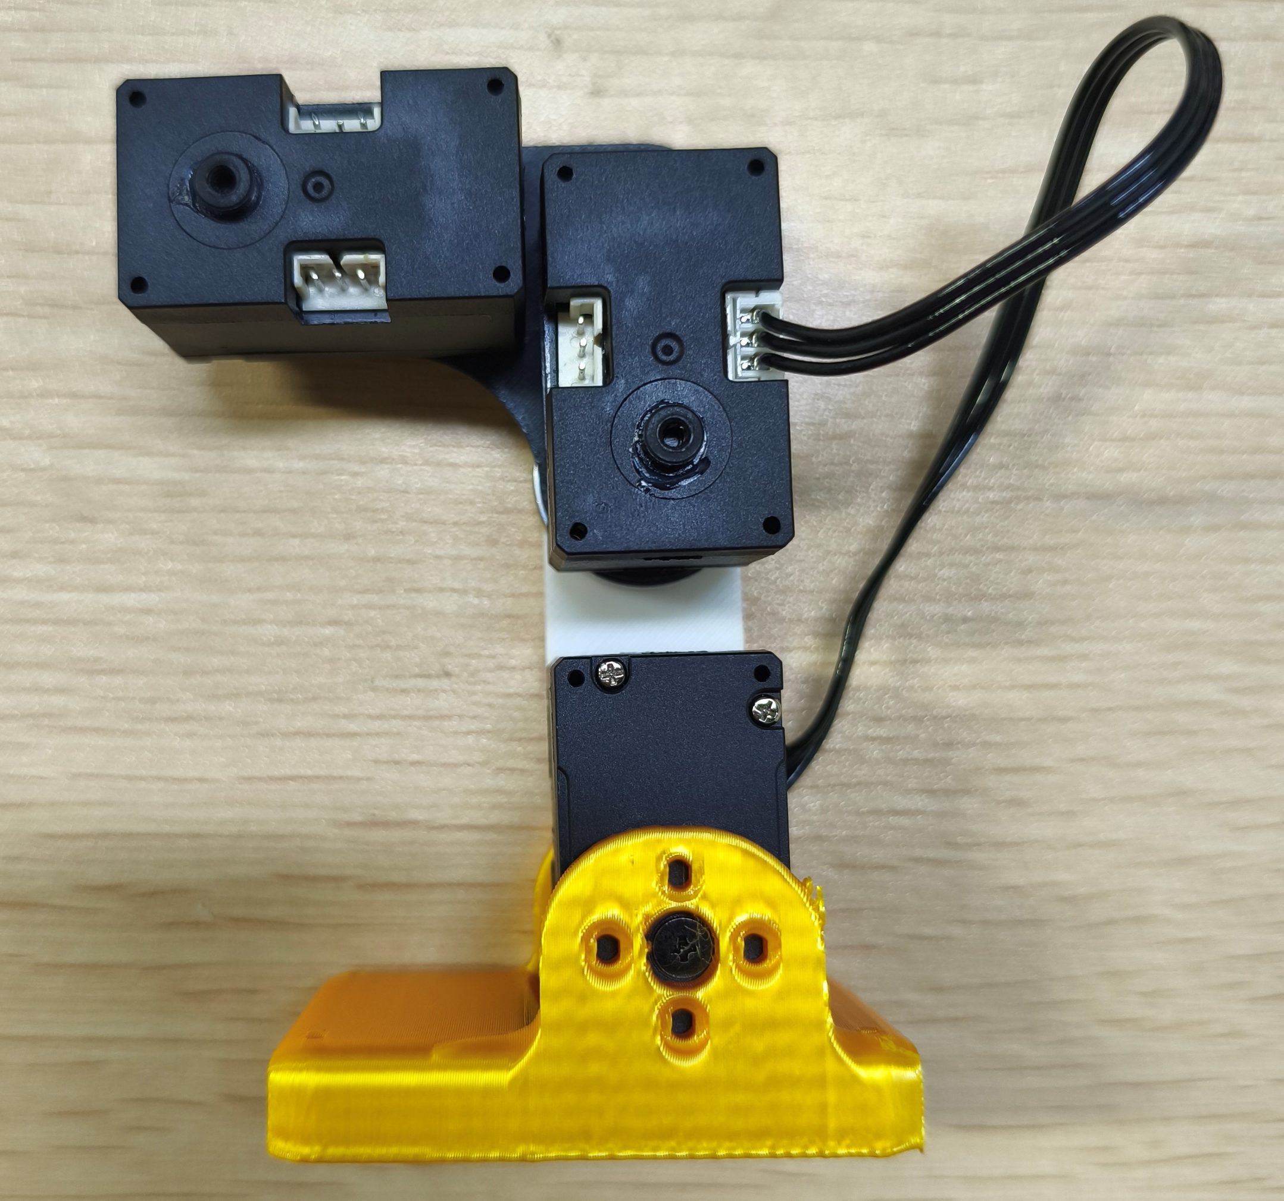
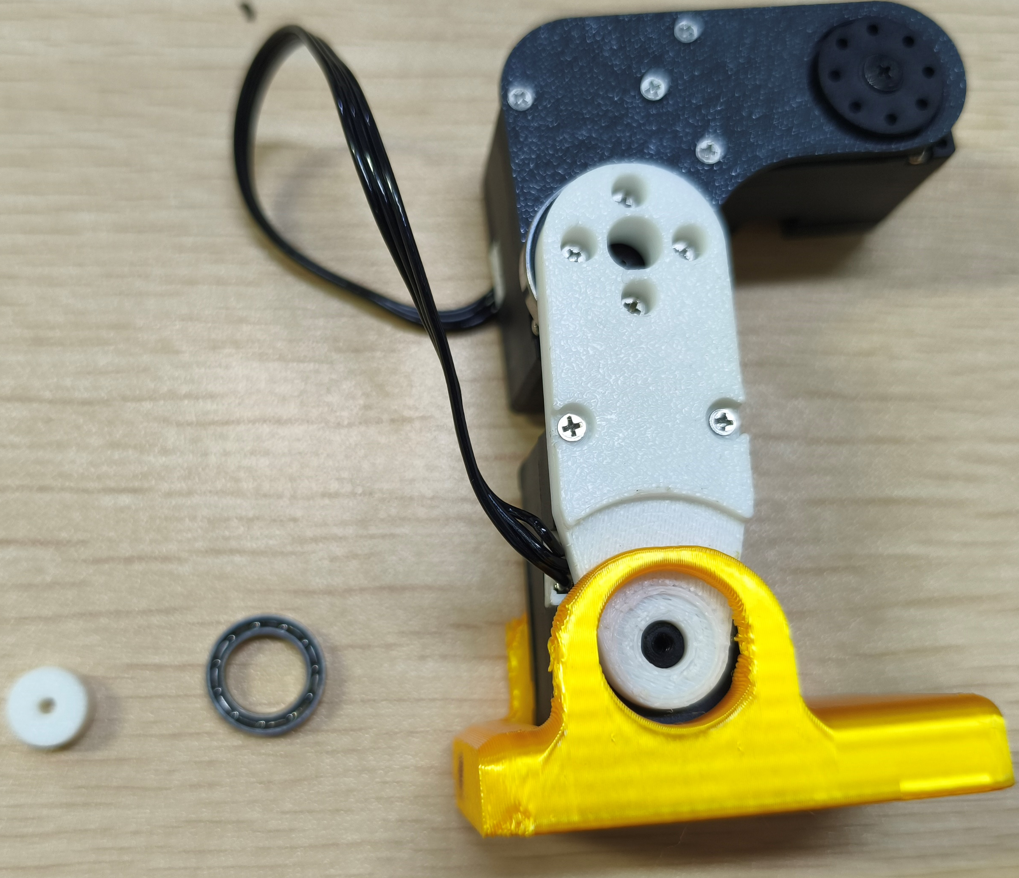
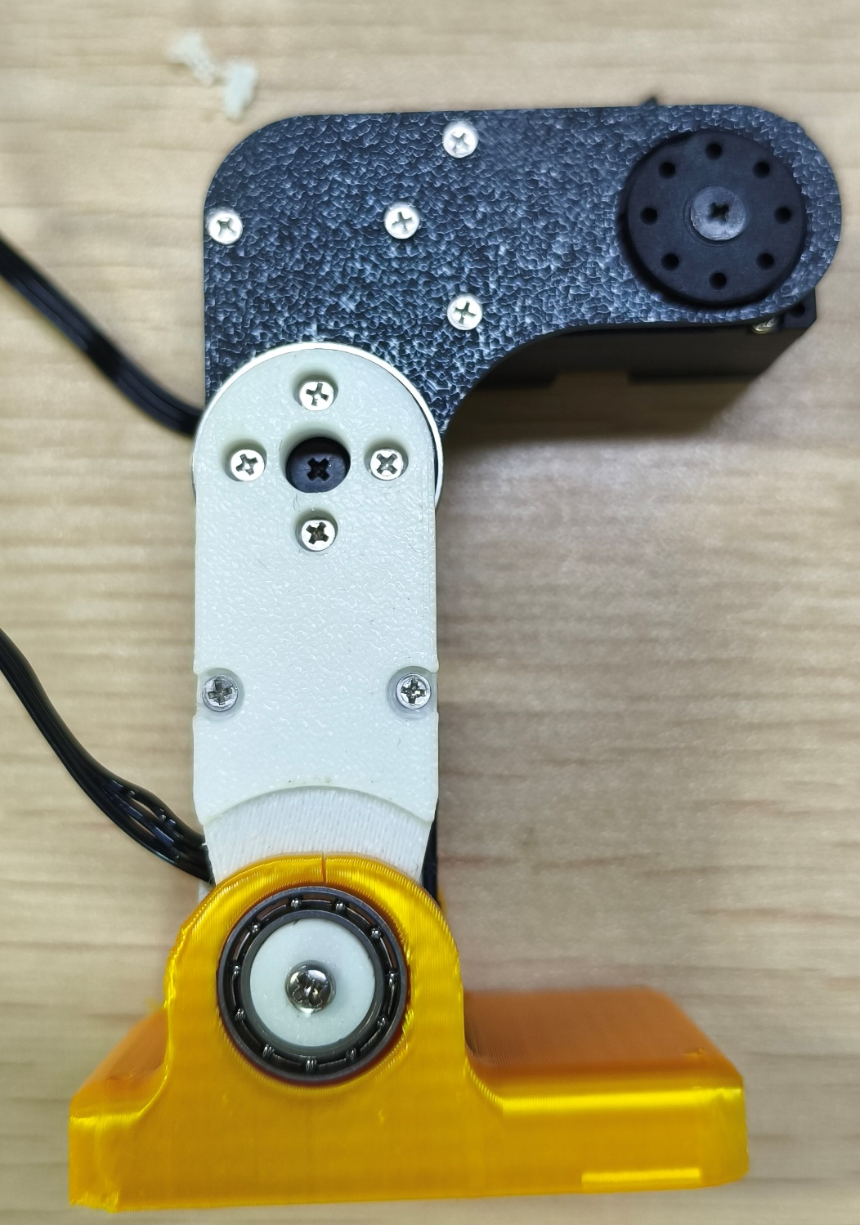
11
脚掌安装
Foot installation
区分左右脚，注意轴承尺寸与螺丝规格。
Distinguish the left and right feet. Check the bearing size and screw specifications.
15×10×3
螺丝
Screws
左图 M2×6 沉头自攻螺丝：4 颗 右图 M2.3×8 平头自攻螺丝
Left: 4 pcs M2×6 countersunk self-tapping screws. Right: M2.3×8 flat-head self-tapping screws.
11 / 25

Slide 12
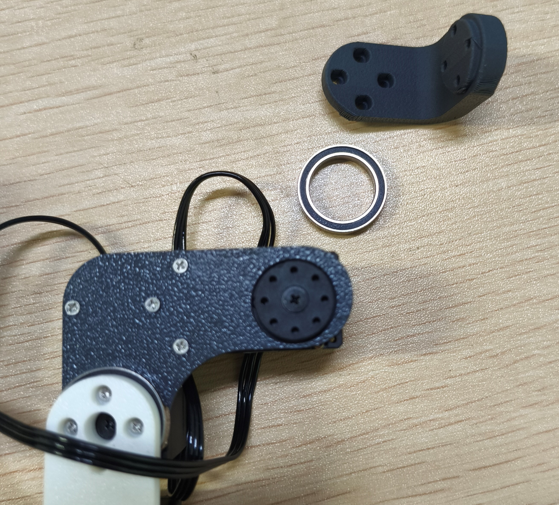
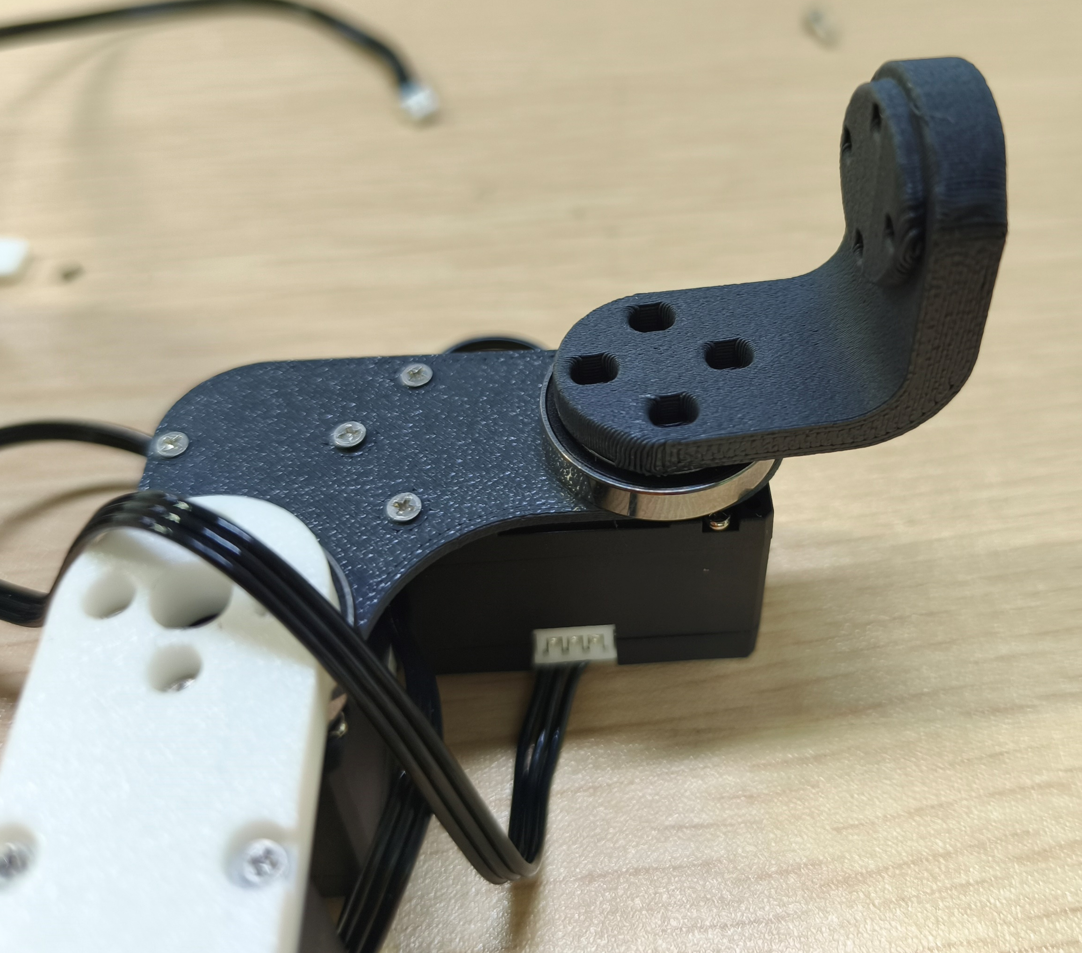
12
腿部上端支架安装
Upper leg bracket installation
沉头自攻螺丝 M2×6：4 颗
M2×6 countersunk self-tapping screws: 4 pcs
12 / 25

Slide 13
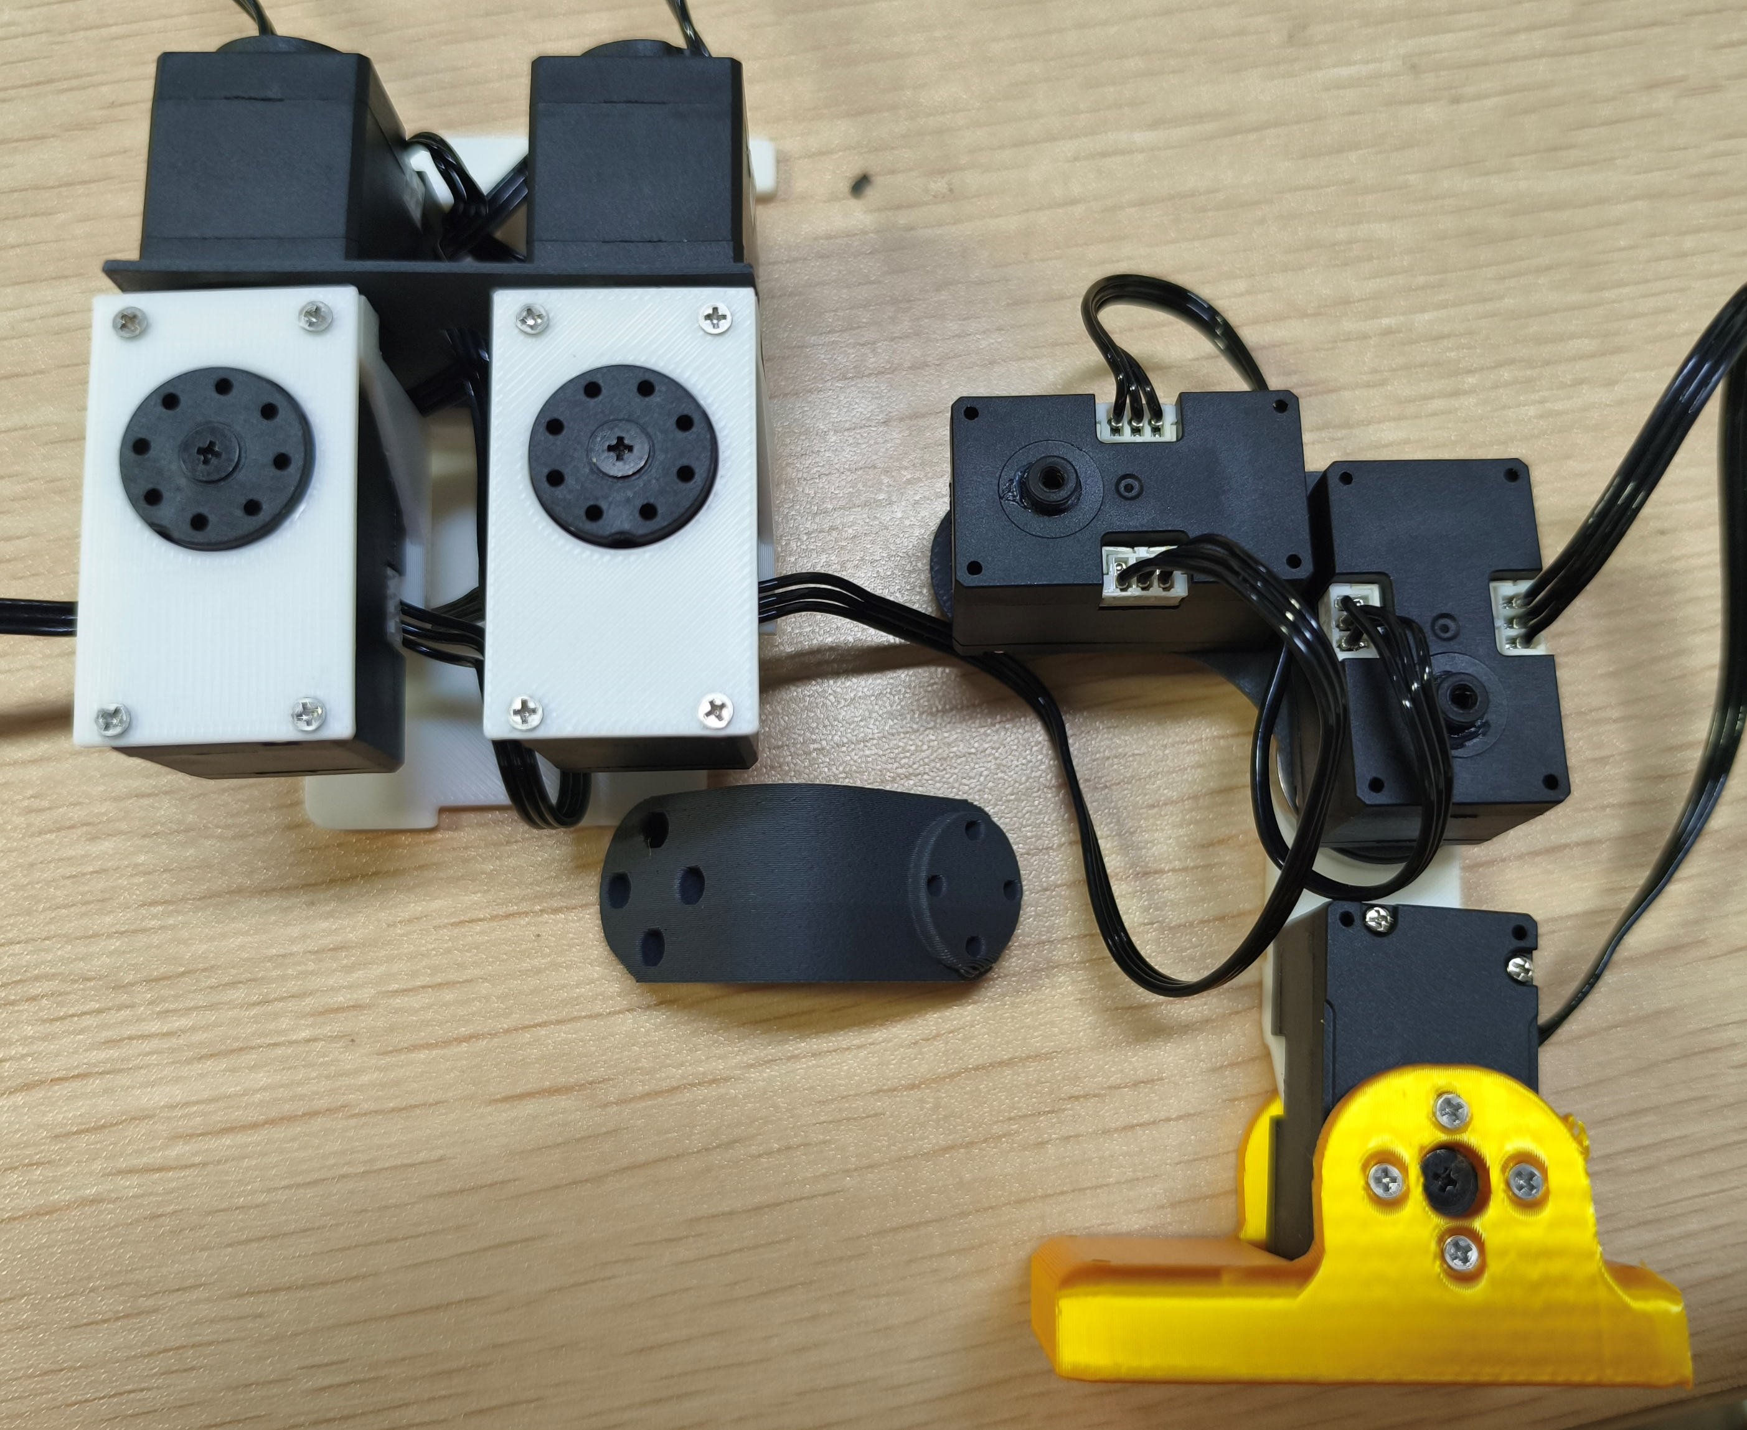
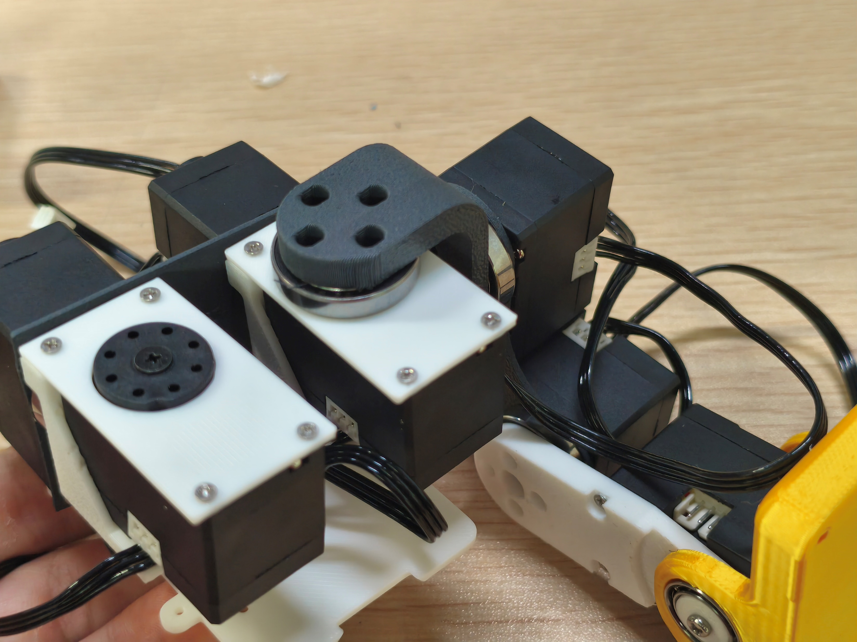
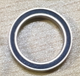
13
腿部与底座连接
Leg-to-base connection
先连接线缆，再将腿部装到底座。
Connect the cables before attaching the legs to the base.
沉头自攻螺丝 M2×6：4 颗
M2×6 countersunk self-tapping screws: 4 pcs
13 / 25

Slide 14
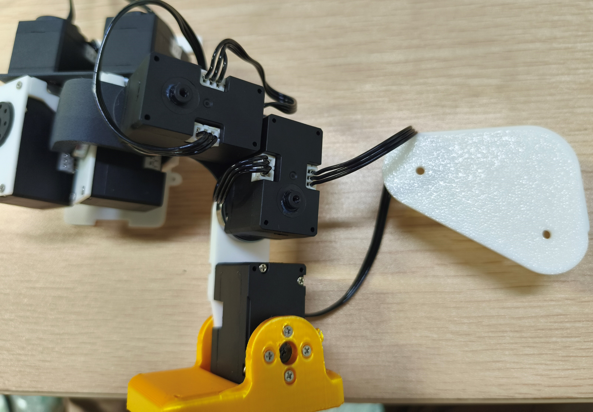
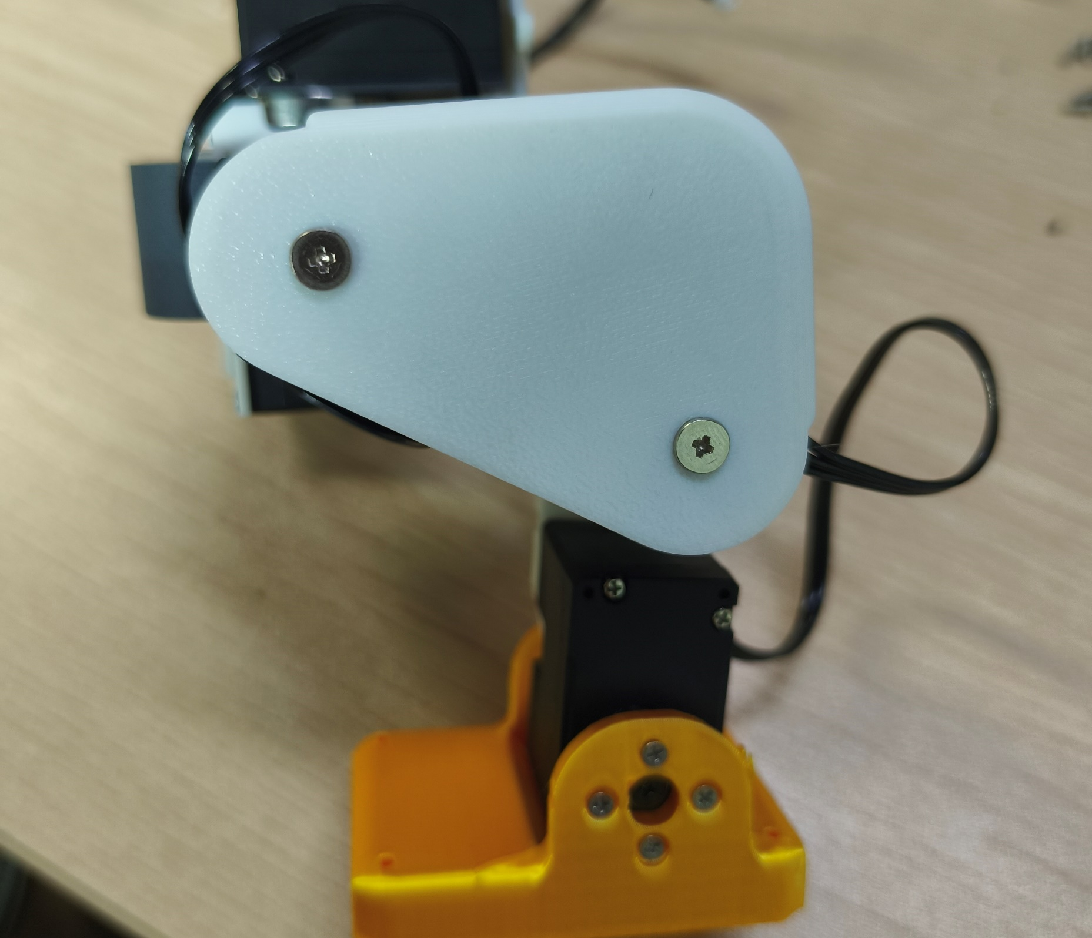
14
腿部侧板固定
Leg side plate attachment
平头自攻螺丝 M2.3×4：2 颗 舵机副舵盘自带螺丝
M2.3×4 flat-head self-tapping screws: 2 pcs. Screws supplied with the secondary servo horn.
14 / 25

Slide 15
15
TPU 脚垫安装
TPU foot pad installation
注意 TPU 脚垫的安装方向。
Check the orientation of the TPU foot pads.
20
10
22
21
11
12
23
13
24
14
15 / 25

Slide 16
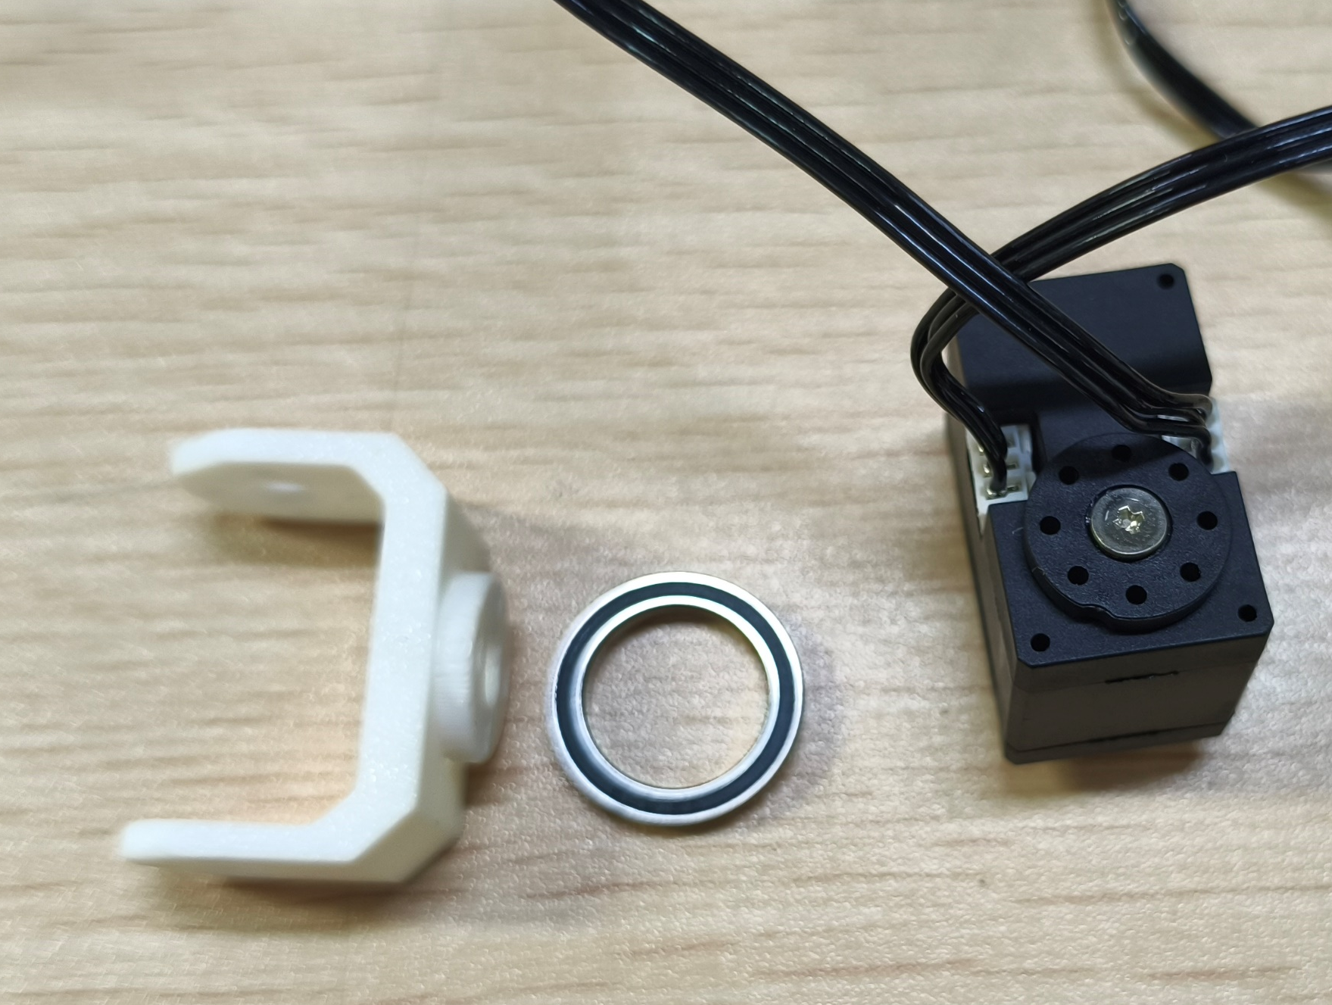
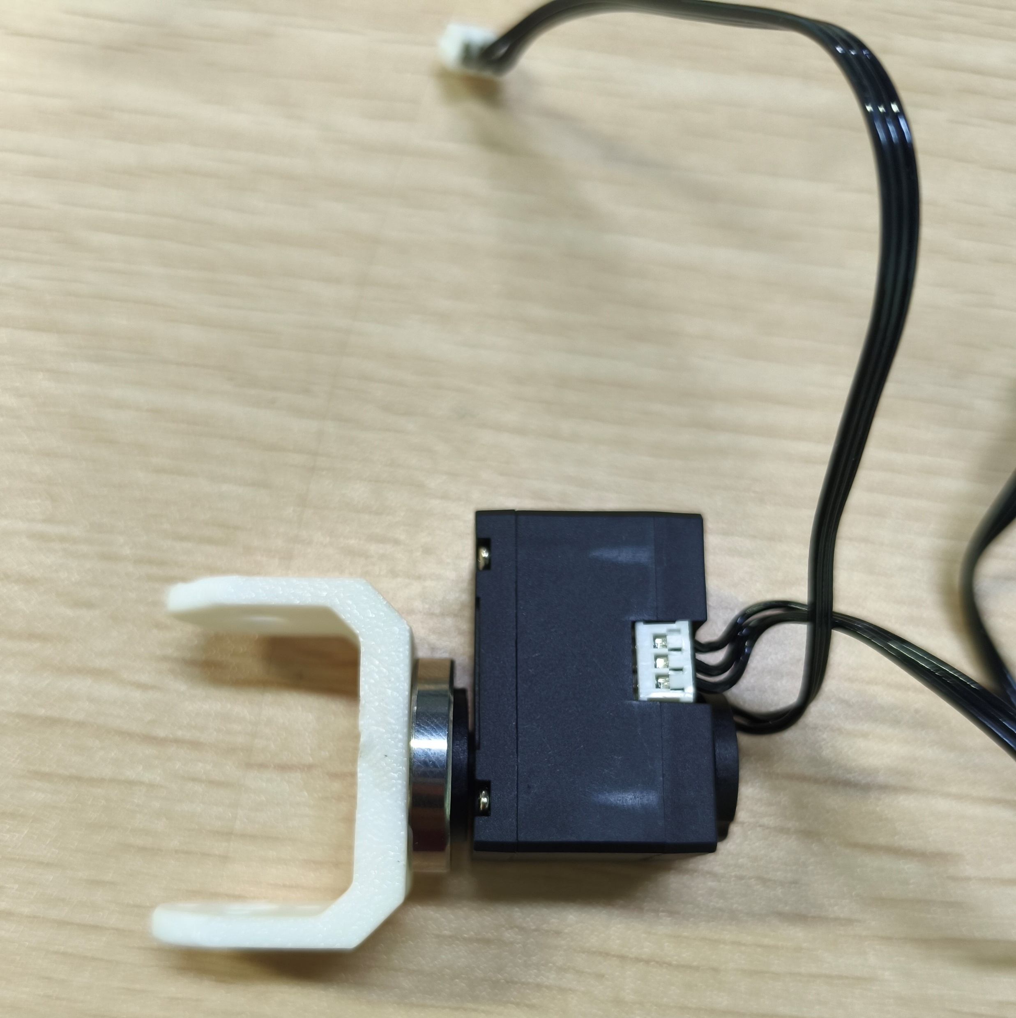
16
ID32 舵机支架安装
ID32 servo bracket installation
先连接线缆，再安装支架。
Connect the cables before installing the bracket.
32
32
沉头自攻螺丝 M2×6：4 颗
M2×6 countersunk self-tapping screws: 4 pcs
16 / 25

Slide 17
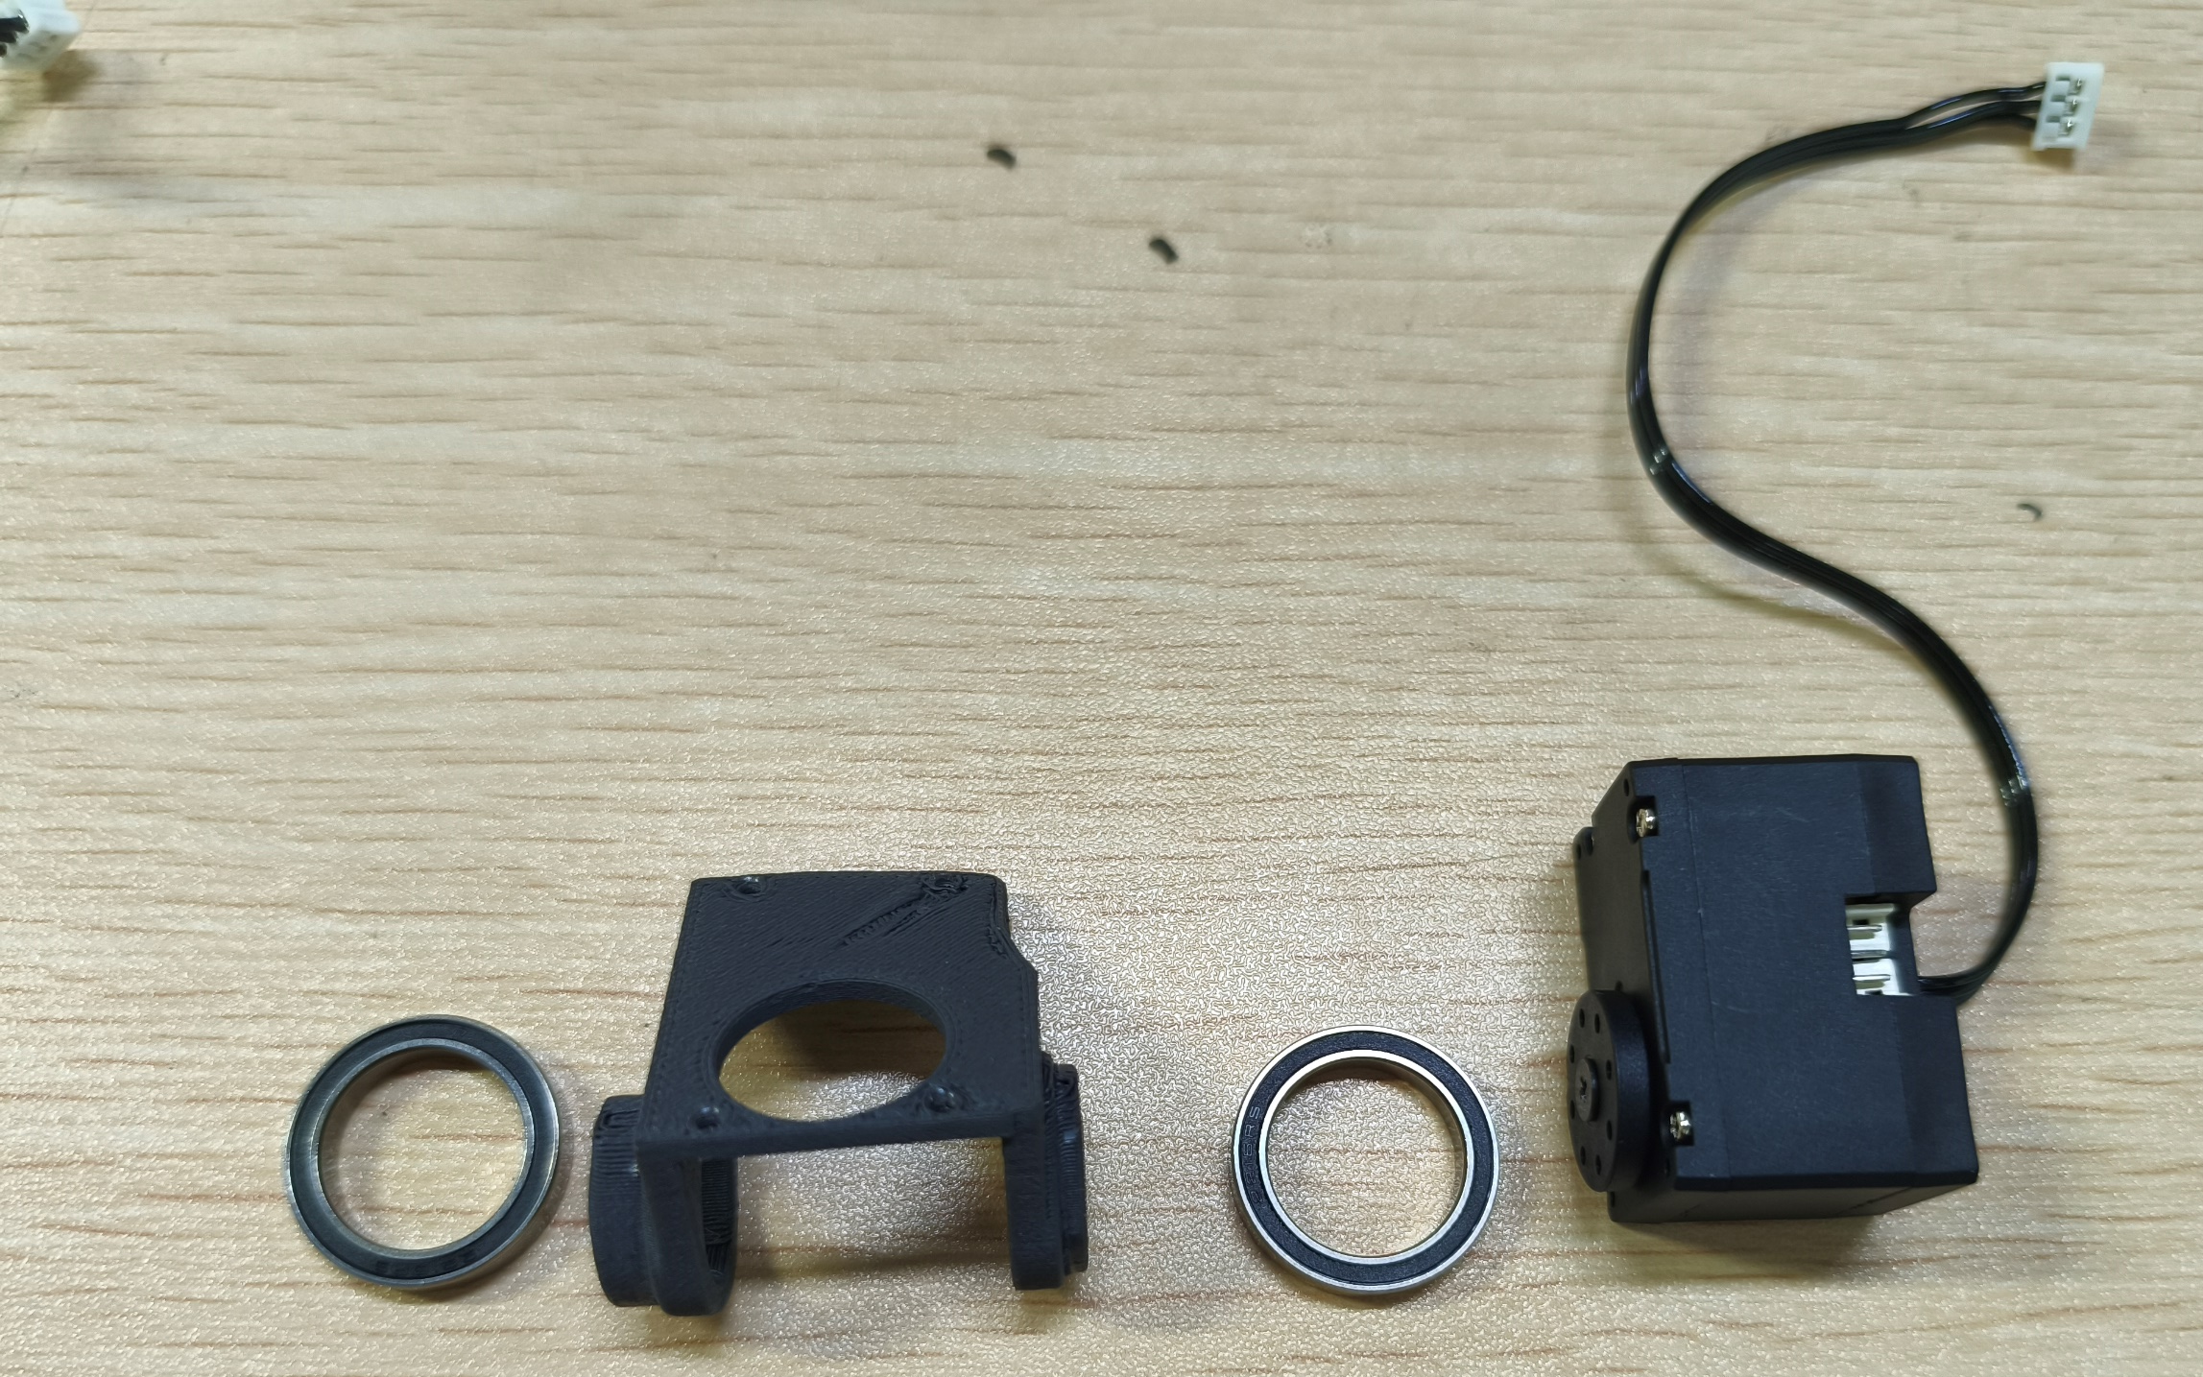
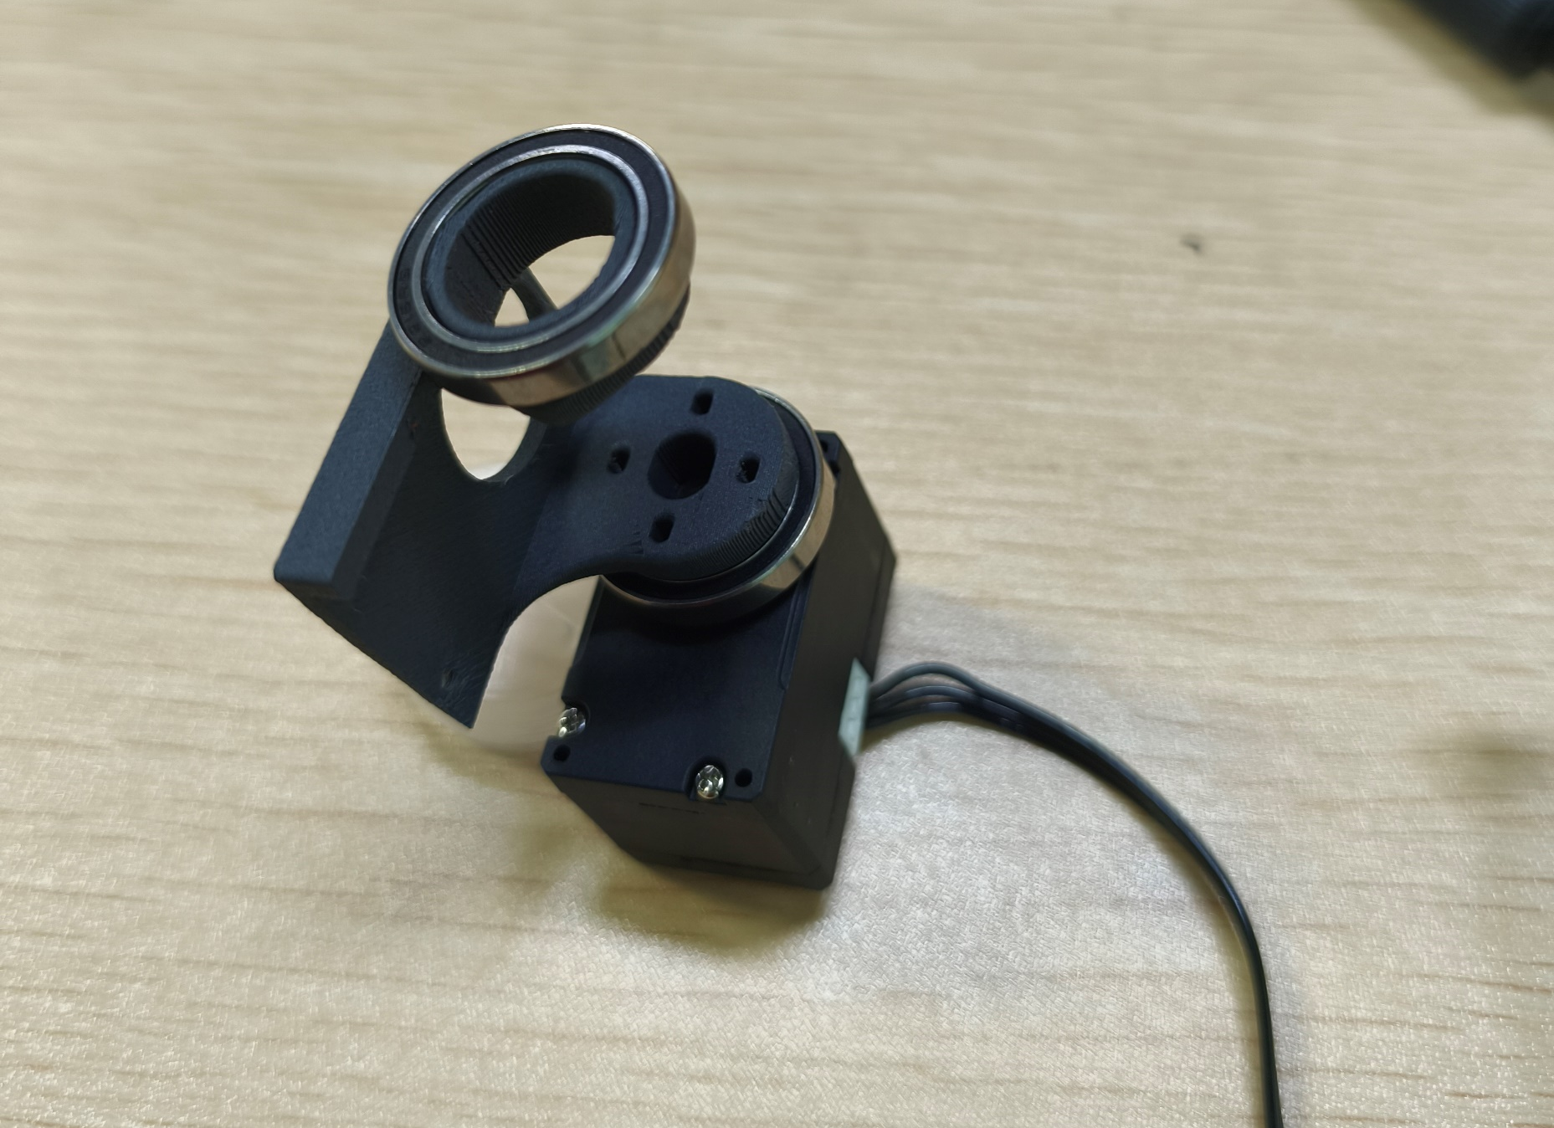
17
ID33 舵机支架安装
ID33 servo bracket installation
先连接底部线缆，再组装支架与轴承。
Connect the bottom cables before assembling the bracket and bearings.
螺丝
Screws
33
33
沉头自攻螺丝 M2×6：4 颗
M2×6 countersunk self-tapping screws: 4 pcs
17 / 25

Slide 18
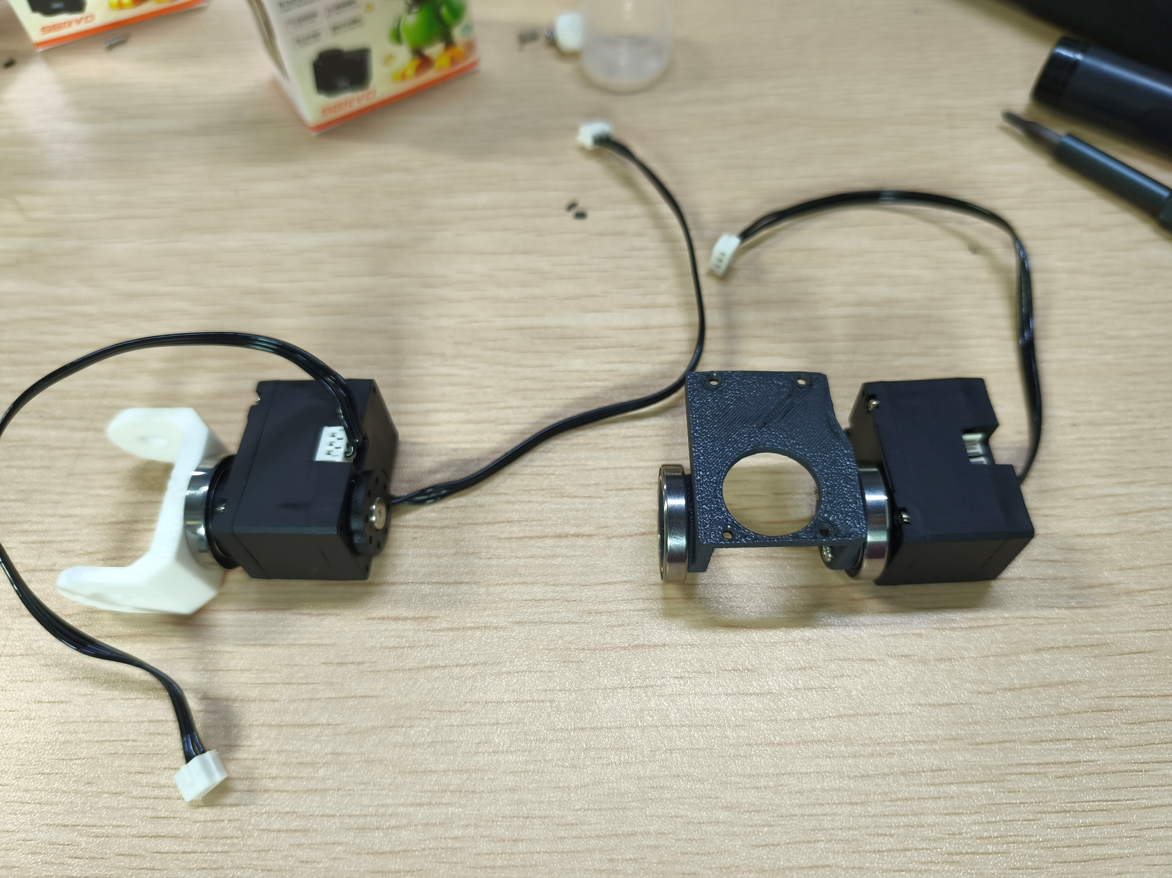
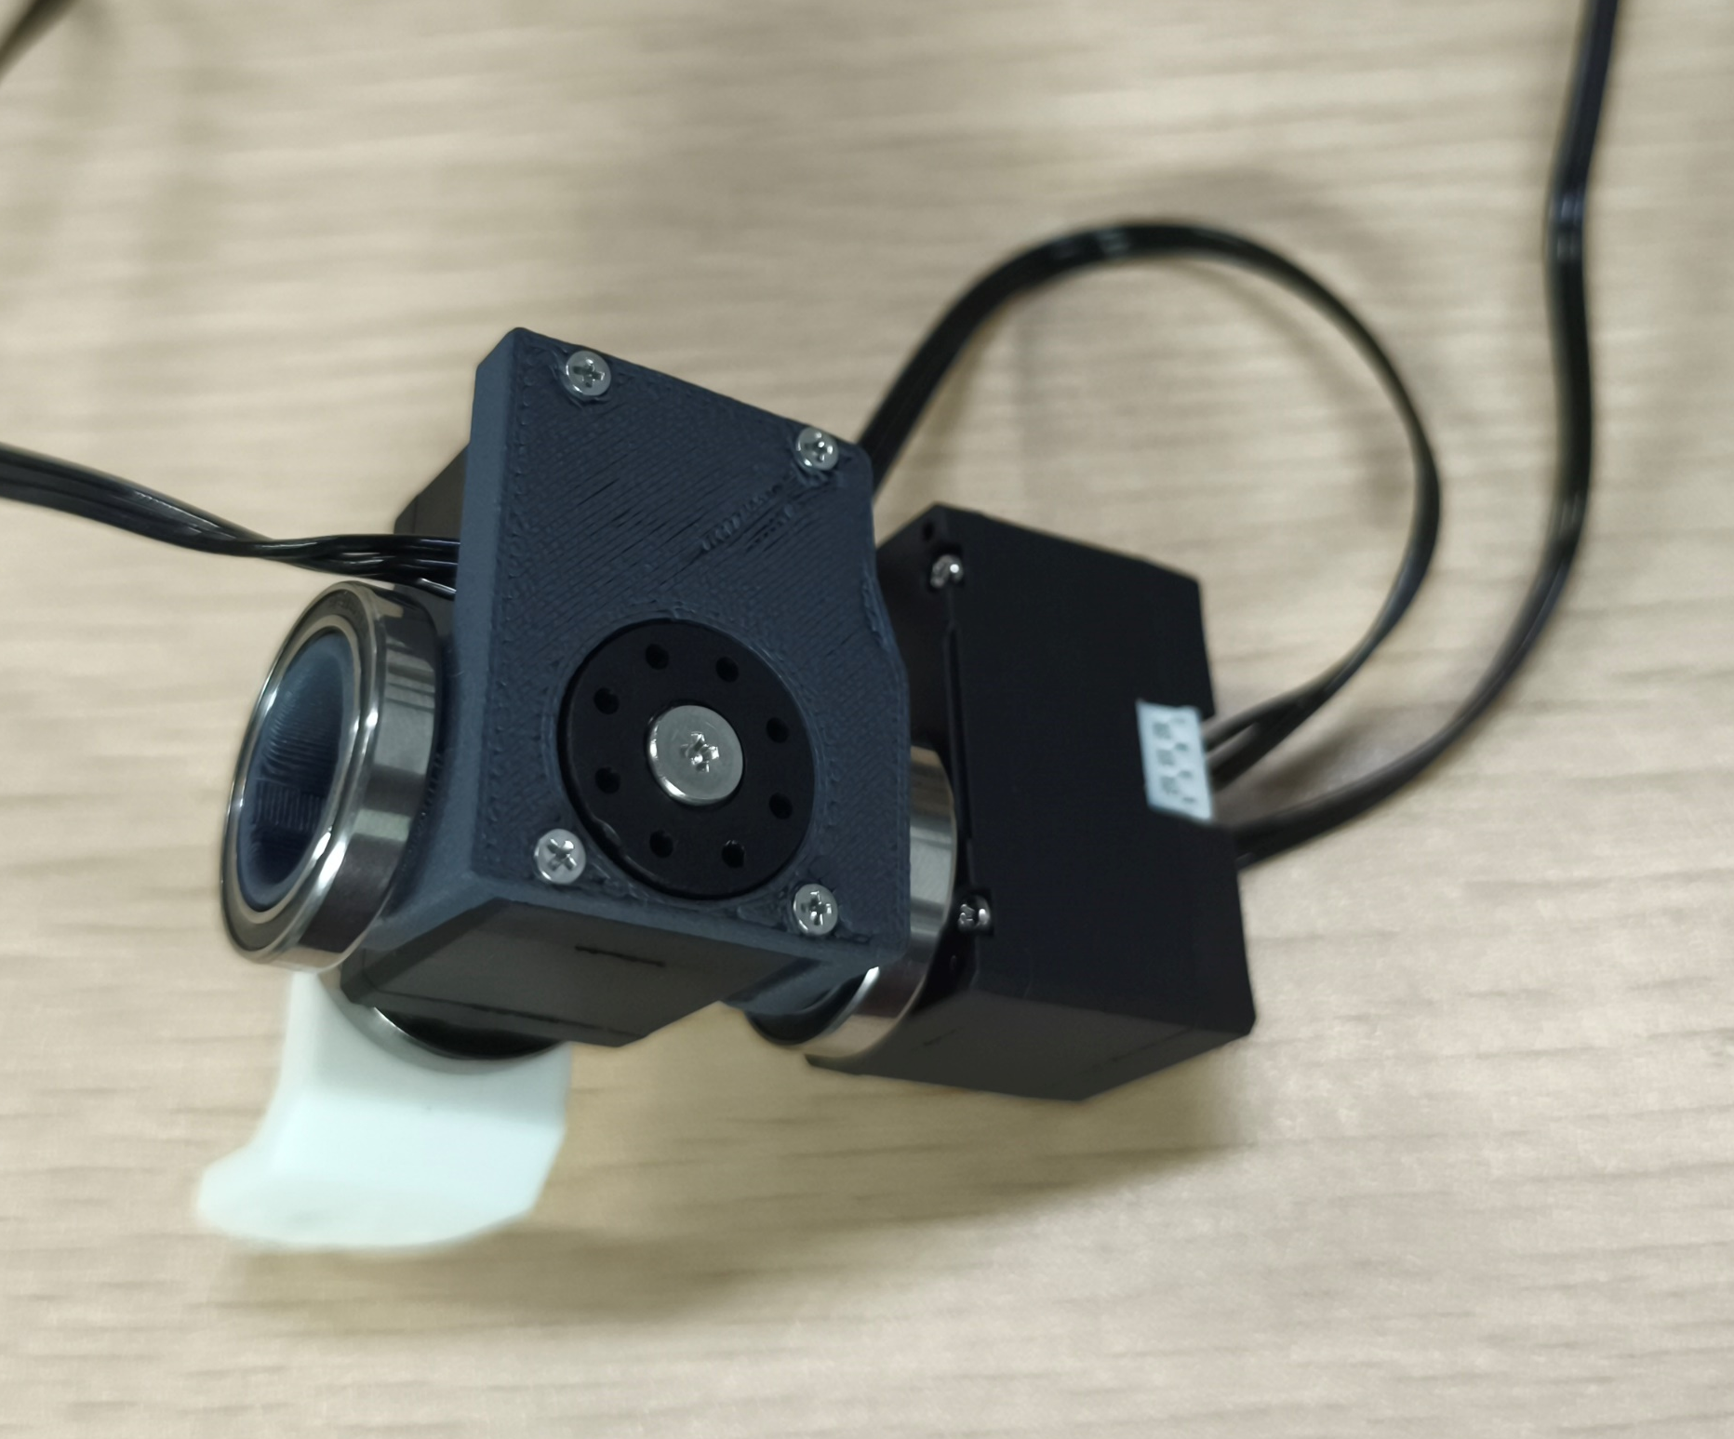
18
ID32 与 ID33 连接
ID32 and ID33 connection
32
33
沉头自攻螺丝 M2×6：4 颗
M2×6 countersunk self-tapping screws: 4 pcs
18 / 25

Slide 19
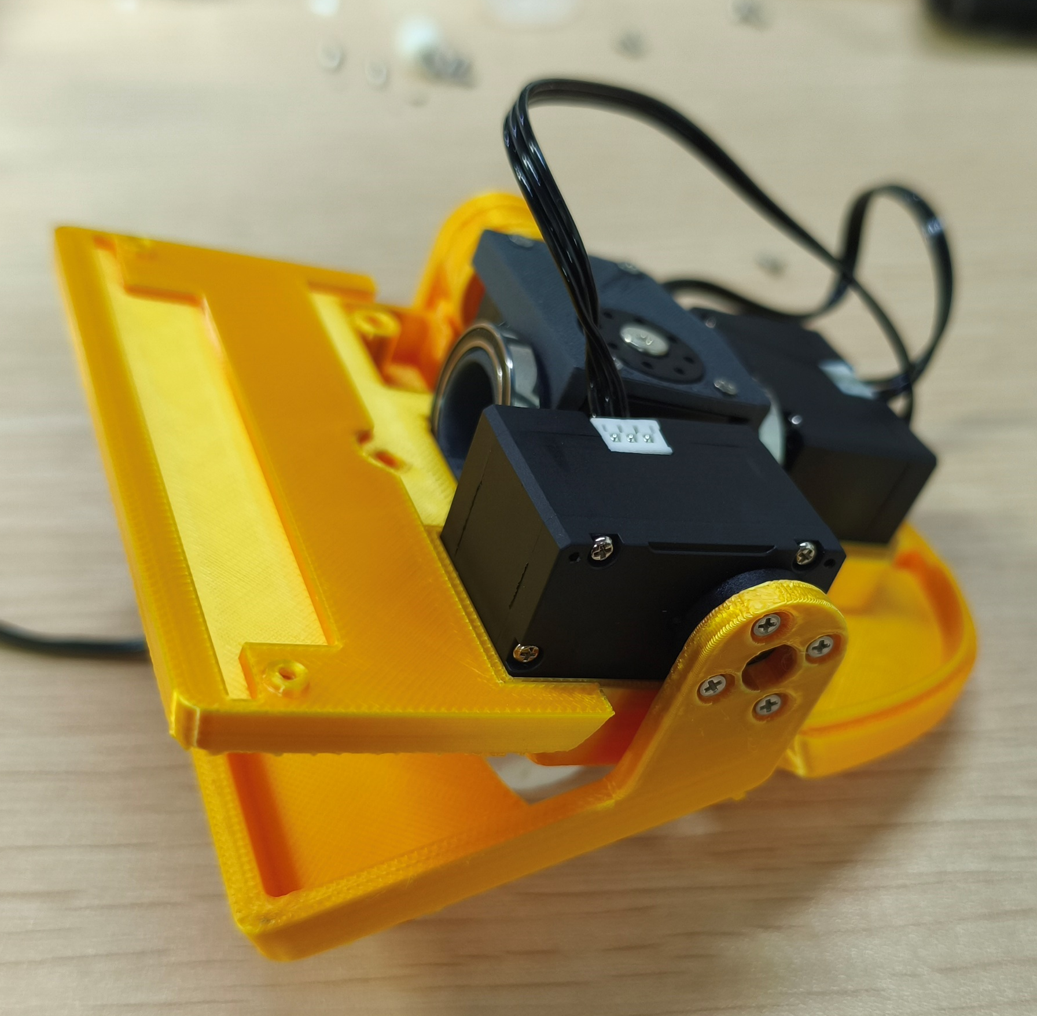
19
ID34 舵机与外壳安装
ID34 servo and housing installation
按图示完成走线。
Route the cables as shown.
32
33
34
沉头自攻螺丝 M2×6：4 颗
M2×6 countersunk self-tapping screws: 4 pcs
19 / 25

Slide 20
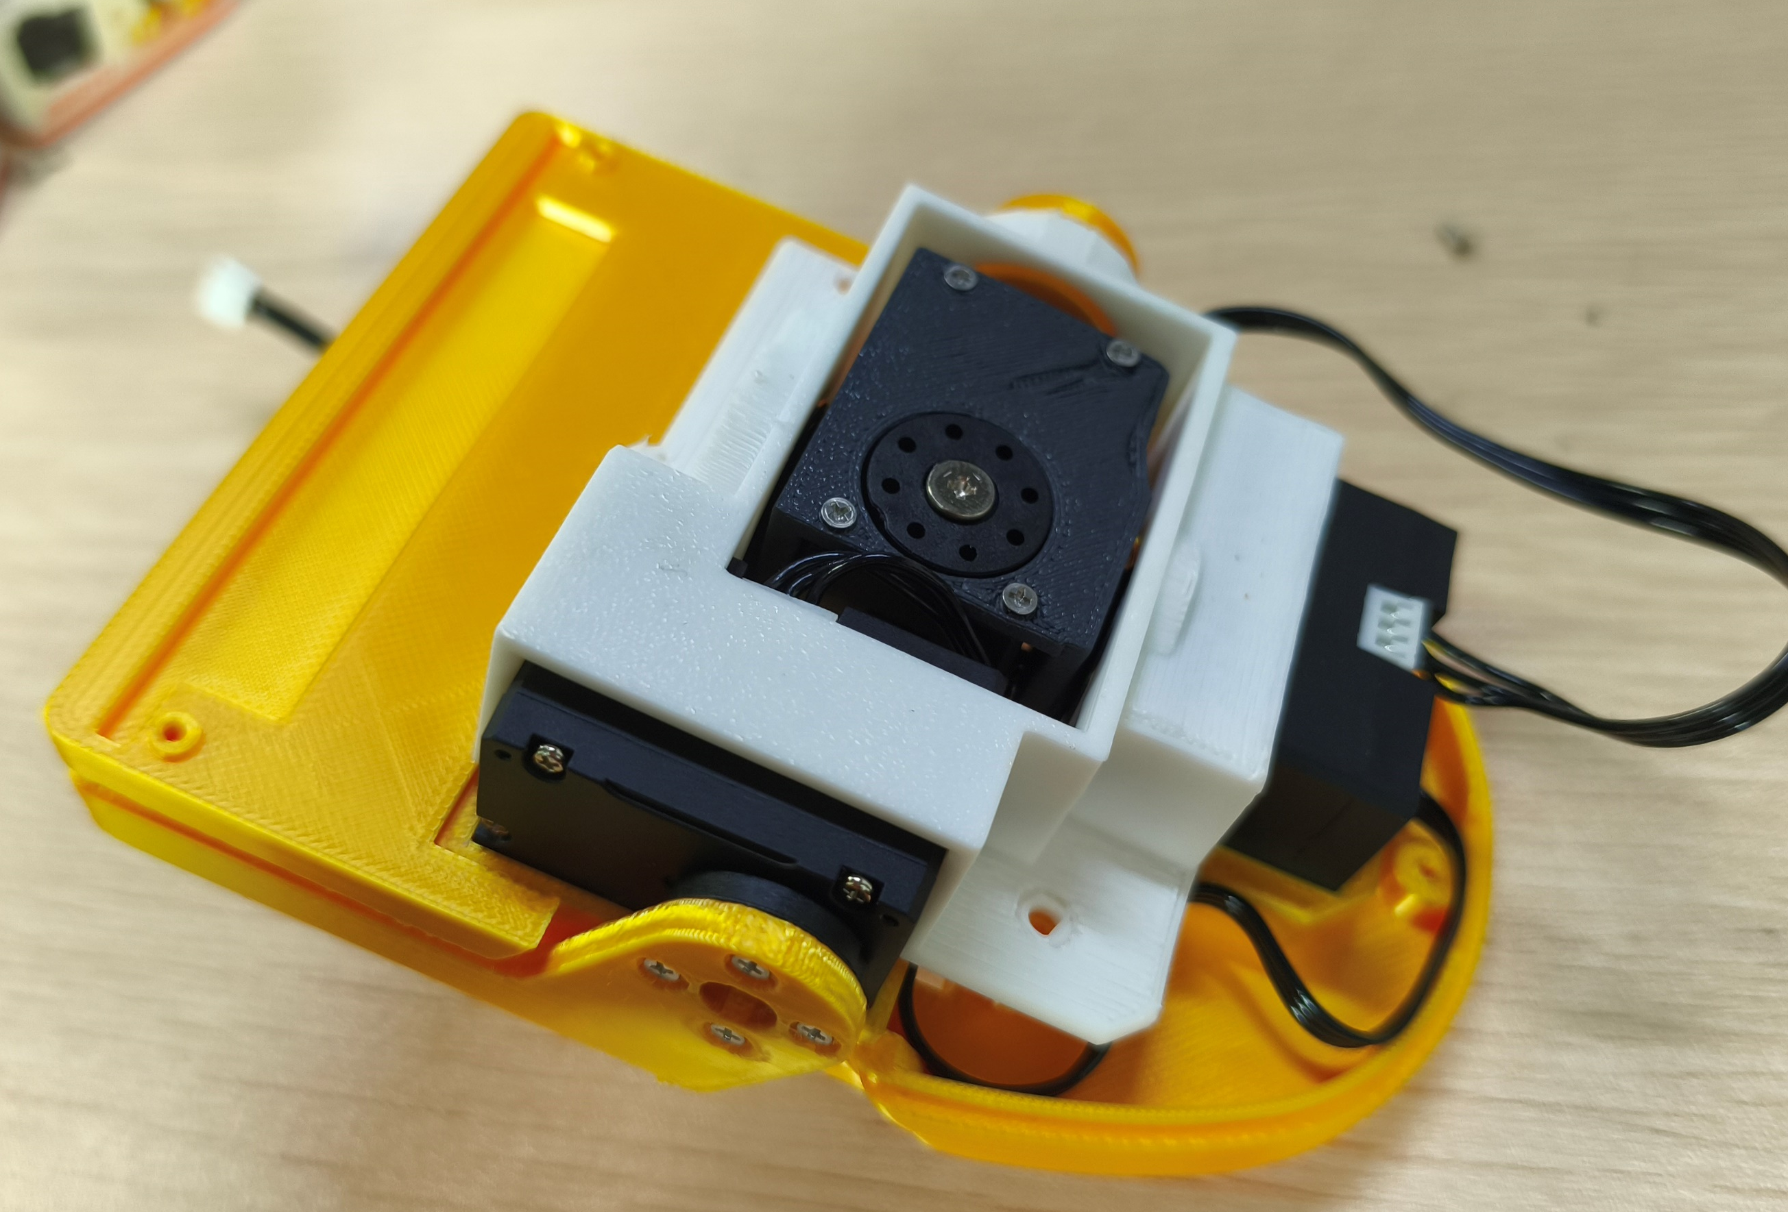
20
外壳与支架固定
Housing and bracket attachment
沉头自攻螺丝 M2×6 左图：4 颗 右图：3 颗
M2×6 countersunk self-tapping screws. Left image: 4 pcs. Right image: 3 pcs.
20 / 25

Slide 21
21
软垫粘贴
Pad attachment
使用双面胶，在箭头所示位置固定软垫。
Use double-sided tape to attach the pads at the positions indicated by the arrows.
粘贴位置
Tape area
固定材料：双面胶
Attachment material: double-sided tape
21 / 25

Slide 22
22
ID30 与 ID31 安装
ID30 and ID31 installation
ID30号舵机连接主板使用15cm长线。
15cm servo cable for servo ID30 to mainboard.
31
30
30
31
双面安装 沉头自攻螺丝 M2×6：16 颗
Both sides: 16 pcs M2×6 countersunk self-tapping screws
22 / 25

Slide 23
23
电池支架与电路板安装
Battery bracket and circuit board
圆头机丝螺丝 M3×16：4 颗
M3×16 round-head machine screws: 4 pcs
23 / 25

Slide 24
24
上部支架安装
Upper bracket installation
沉头自攻螺丝 M2×6：4 颗
M2×6 countersunk self-tapping screws: 4 pcs
24 / 25

Slide 25
25
上下组件连接
Upper and lower assembly connection
两面分别固定，螺丝数量按每面计算。
Secure both sides. The screw quantity is specified per side.
沉头自攻螺丝 M2×6：每面 4 颗
M2×6 countersunk self-tapping screws: 4 pcs per side
25 / 25

